Slide 1
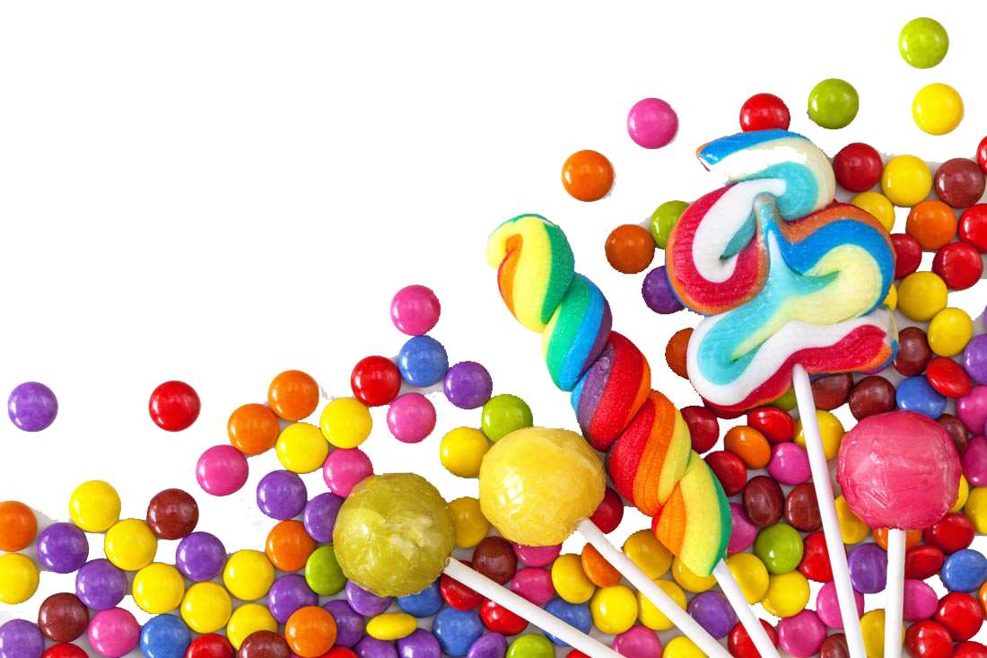
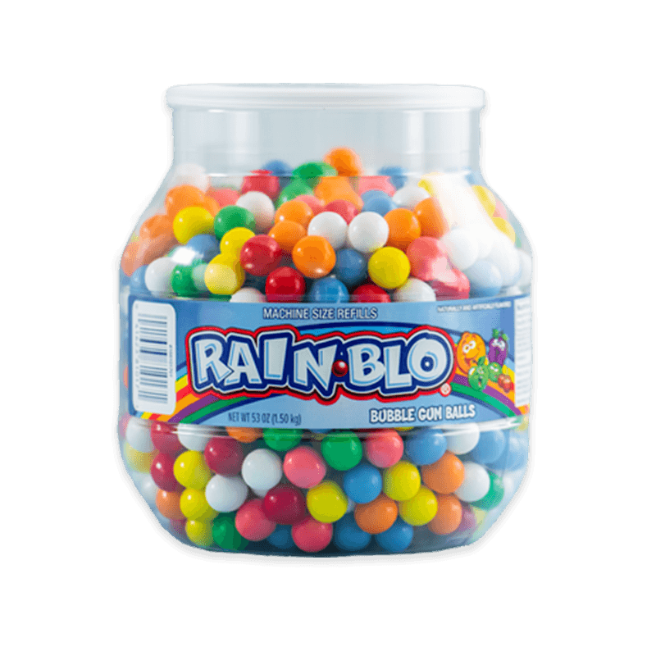
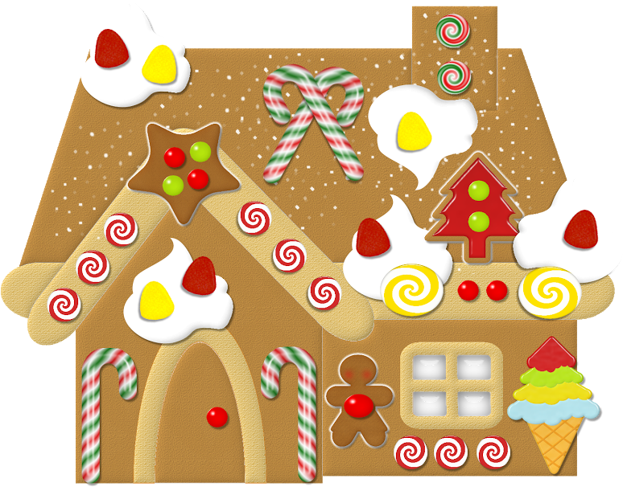
Go forward
2 spaces
Go to the next green space
START
Do 5 jumping jacks
Stretch and take 3 deep breaths
Go back 2 spaces
FINISH

