Slide 1
Pet Parade
Created by MaryKate Lindemann, Occupational Therapy Student
Utica College
Supervising Fieldwork Coordinator:
Kim Wiggins, OTR/L

Slide 2
Directions:
Your job is to organize a pet parade by helping the animals get into costume and completing tasks.
Have the child write a list of foods for the pets. You can use the annotate feature to write these on the clipboard for the child to copy.
Draw and cut out a rectangle, then draw a circle on one side and a smaller rectangle on the other. You can draw a picture in the smaller rectangle to make it look like they’re actually taking a picture!
Have the child identify the incomplete wire to repair the lights.
Push the boxes off the stage (I like to have the child push on a wall)
When the alarm rings it’s time to start!
Share your sound because the sound effects make it even more fun!
If you decide to share, please instruct people to obtain this from the www.OTKimWiggins.com website.
Have fun!

Slide 3
Let’s Go To a
Pet Parade!

Slide 4
To Do List:
Snacks!
Camera
Fix Lights
Clear Stage

Slide 5
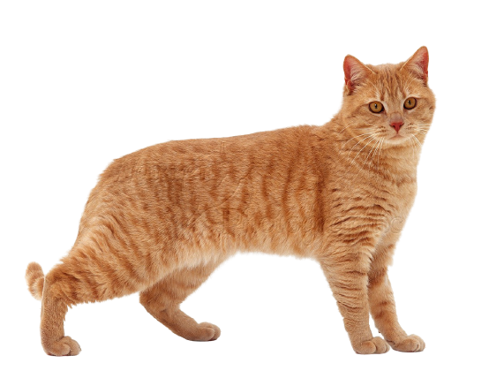

Slide 6
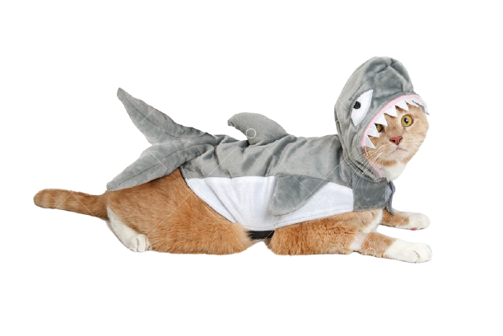

Slide 7
To Do List:
Snacks!
Camera
Fix Lights
Clear Stage

Slide 8
_________________
_________________
_________________
_________________
_________________

Slide 9
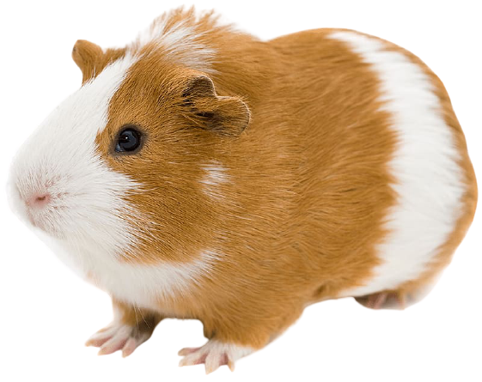

Slide 10
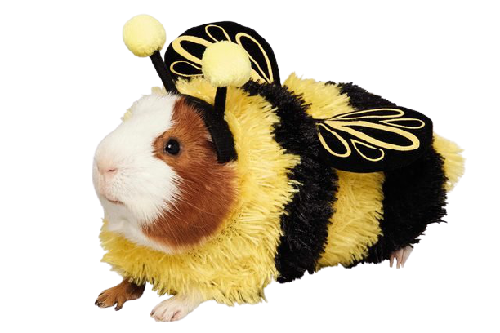

Slide 11
To Do List:
Snacks!
Camera
Fix Lights
Clear Stage

Slide 12
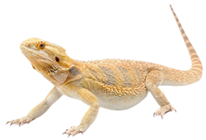

Slide 13
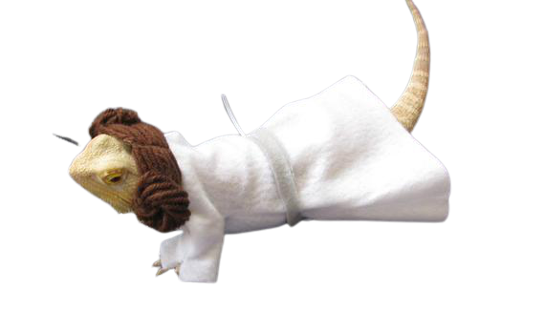

Slide 14
To Do List:
Snacks!
Camera
Fix Lights
Clear Stage

Slide 15
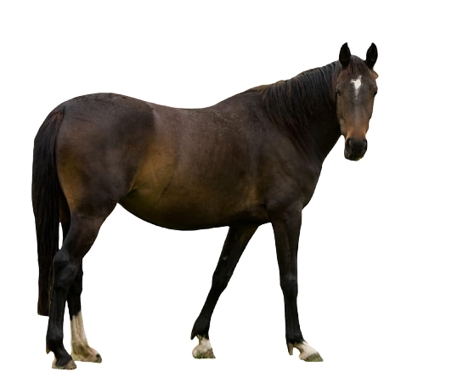

Slide 16
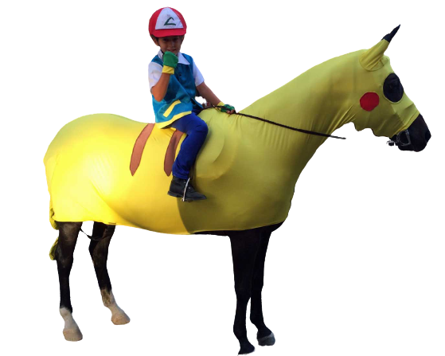

Slide 17
To Do List:
Snacks!
Camera
Fix Lights
Clear Stage

Slide 18
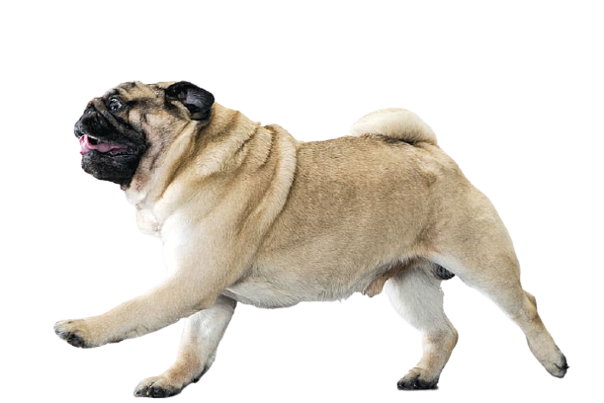

Slide 19
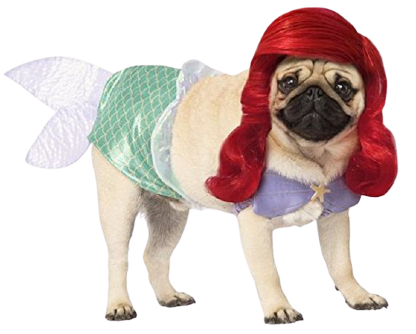

Slide 20
To Do List:
Snacks!
Camera
Fix Lights
Clear Stage

Slide 25
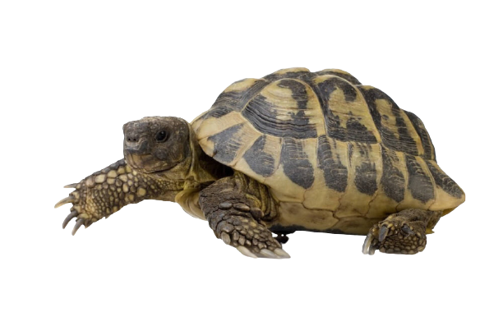

Slide 26
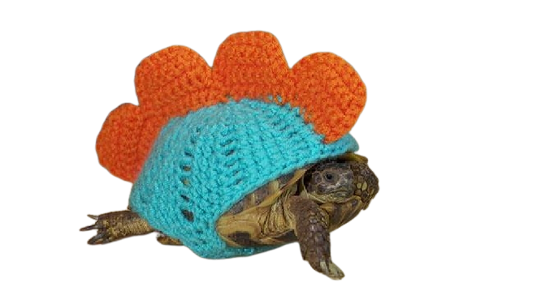

Slide 27
To Do List:
Camera
Snacks!
Fix Lights
Clear Stage

Slide 28
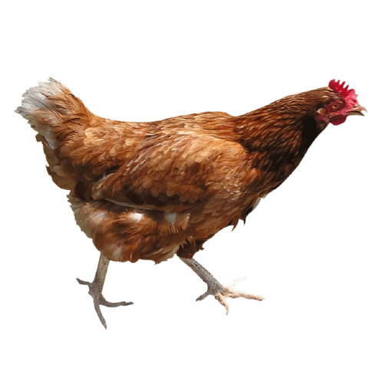

Slide 29
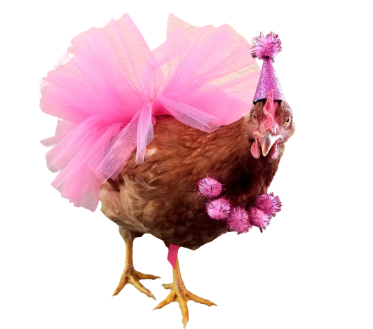

Slide 30
To Do List:
Camera
Snacks!
Fix Lights
Clear Stage

Slide 32
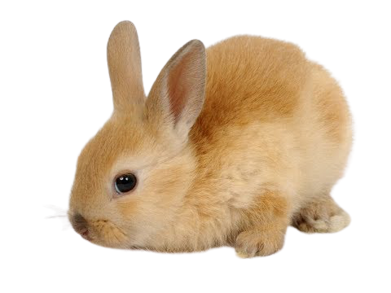

Slide 33
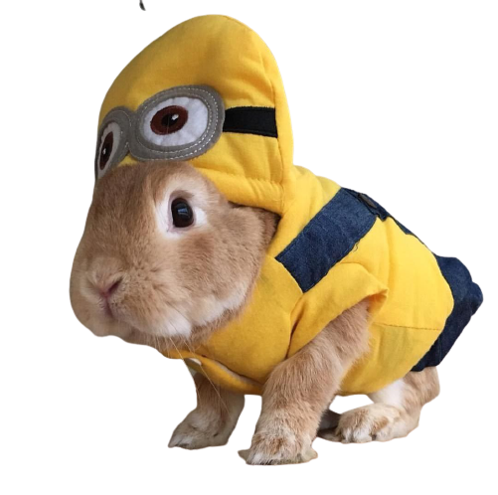

Slide 36
