Slide 1
Created by Kim Wiggins, OTR/L
www.OTKimWiggins.com
This Photo by Unknown Author is licensed under CC BY-NC-ND

Slide 2
Directions:
Created by Kim Wiggins, OTR/L
www.OTKimWiggins.com
This activity can be used across multiple sessions! There are a lot of parts!
Share your screen. There are animations and sound effects that are very motivating to the students. Therefore, it is not as much fun to use it as a virtual background.
Open the PowerPoint and present the slide show starting from the main carnival slide on slide 3.
Once you are on the carnival slide ask the students what ride or area they would like to go to. Click on the TICKETS icon in the bottom right corner. To “pay” for the ride they will need to write/type the name of the ride. Then click on the icon next to the name of the ride. If you would like to skip this part, you can simply click on each ride icon.
Types of icons:
Games: The green titles are online games. You can copy and paste the links and give to the student in the chat feature OR they can give you verbal directional terms to complete the tasks.
When they finish the online game, go back to the presented PowerPoint and click in any white area to reveal their PRIZE. All of the game slides have prizes except for the spinning wheel. Then click on the icon at the bottom left to return to the main slide.
Food: There is one food icon and one lemonade stand. The are several choices inside the food choices.
Click once on the picture next to the food’s name.
Instruct the student to perform the task on that slide in order to “pay” for the food.
Then click on the icon at the bottom left to return to the main slide.
Rides:
Write or type the name of the ride to pay for the ride or create your own activity to “pay” for the ticket. Some rides have an additional activity once you get to the ride page (which suggests “Uh Oh! You need TWO tickets for this ride!”
Click once on the picture next to the ride’s name. The ride will open up.
Always click one more time to hear the sound effect or watch the corresponding GIF.
Then click on the icon at the bottom left to return to the main slide.
DON’T FORGET to turn on your computer sound when you share your screen on ZOOM! All sound effects from www.Zapsplat.com
Google photos downloaded with credit given on each slide.
Please give credit to OTKimWiggins when using this presentation. Instruct others to download from the www.OTKimWiggins.com website.

Slide 3
Rollercoaster
Ferris Wheel
Carousel
Screamer
Balloon Pop
Scrambler
Tea Cups
Basketball
Memory
Ring of Fire
Duck Maze
FOOD
Spin the Wheel
Bumper Cars
Pirate Ship
Rock Wall
Lemonade
This Photo by Unknown Author is licensed under CC BY-SA
This Photo by Unknown Author is licensed under CC BY

Slide 4
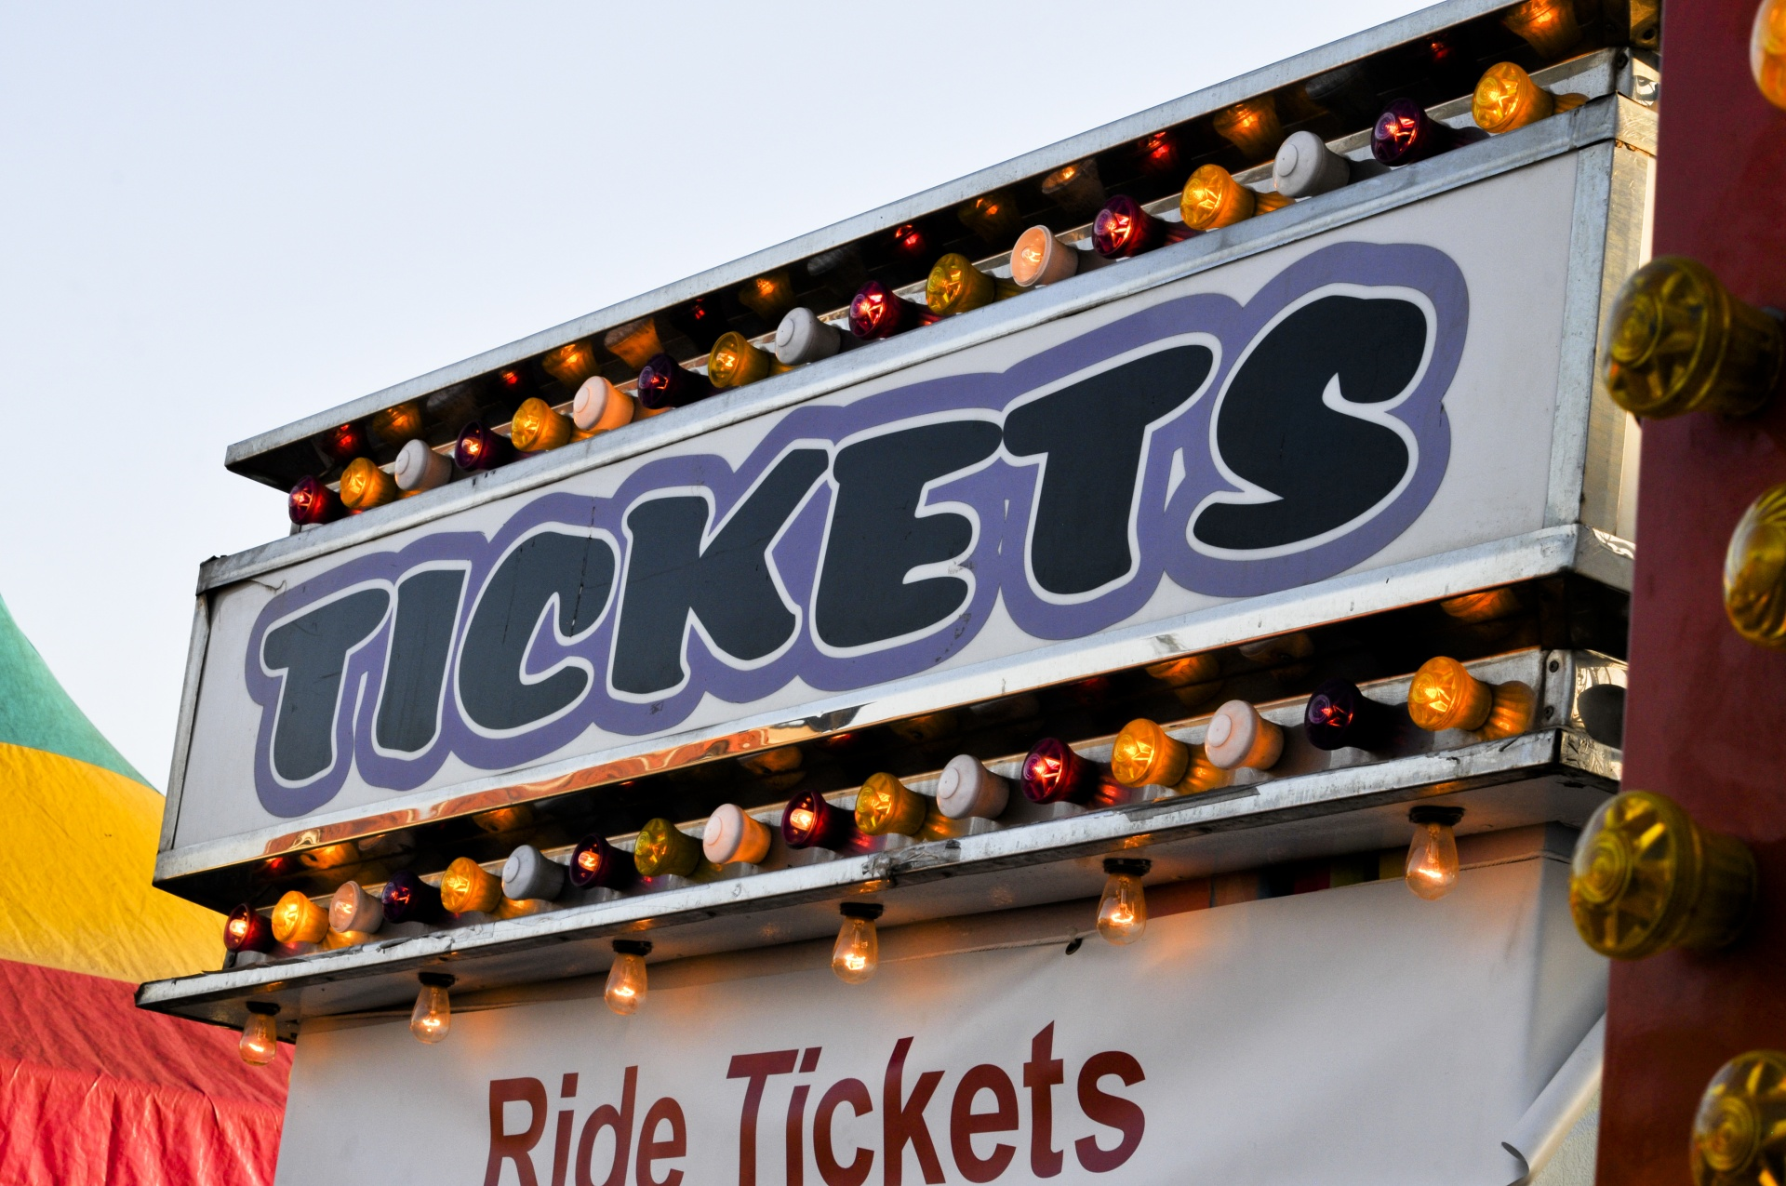
Write the name of the ride to redeem your ticket!
Bumper Cars
Scrambler
Screamer
Ring of Fire
Ferris Wheel
Rollercoaster
Pirate Ship
Rock Wall
Carousel
Tea Cups

Slide 5
FUNNEL CAKE
This Photo by Unknown Author is licensed under CC BY-NC-ND

Slide 6
$ Pay $ Draw/Design a cold drink!
Cold Drink
This Photo by Unknown Author is licensed under CC BY-SA

Slide 7
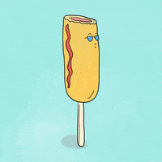
$ Pay $ March 10 times.
Corn Dogs
This Photo by Unknown Author is licensed under CC BY
Corn dog GIF: https://media3.giphy.com/media/3oEjHGIMl0qrDHamqs/200.gif

Slide 8
$ Pay $ Write/Type: funnel cake
Funnel Cake
This Photo by Unknown Author is licensed under CC BY-SA
https://media.tenor.com/images/fc0a61ee26a9e7360c66df495826bdd4/tenor.gif

Slide 9
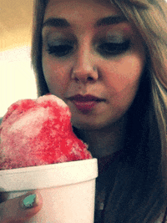
$ Pay $ Write/Type a sentence: Snow cones taste _________.
Snow Cone
This Photo by Unknown Author is licensed under CC BY

Slide 10
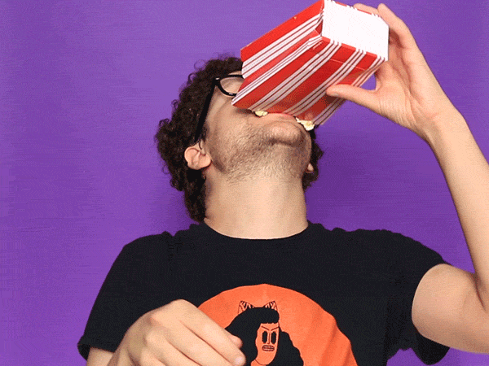
$ Pay $ Create a popcorn craft.
Popcorn
https://media4.giphy.com/media/d31wXL2CoYtWoIJG/giphy.gif

Slide 11
$ Pay $ Write/Type a sentence: Nachos taste _________.
Nachos
This Photo by Unknown Author is licensed under CC BY-NC
https://media.tenor.com/images/075f58edc983dee4bb4c489ab9018c43/tenor.gif

Slide 12
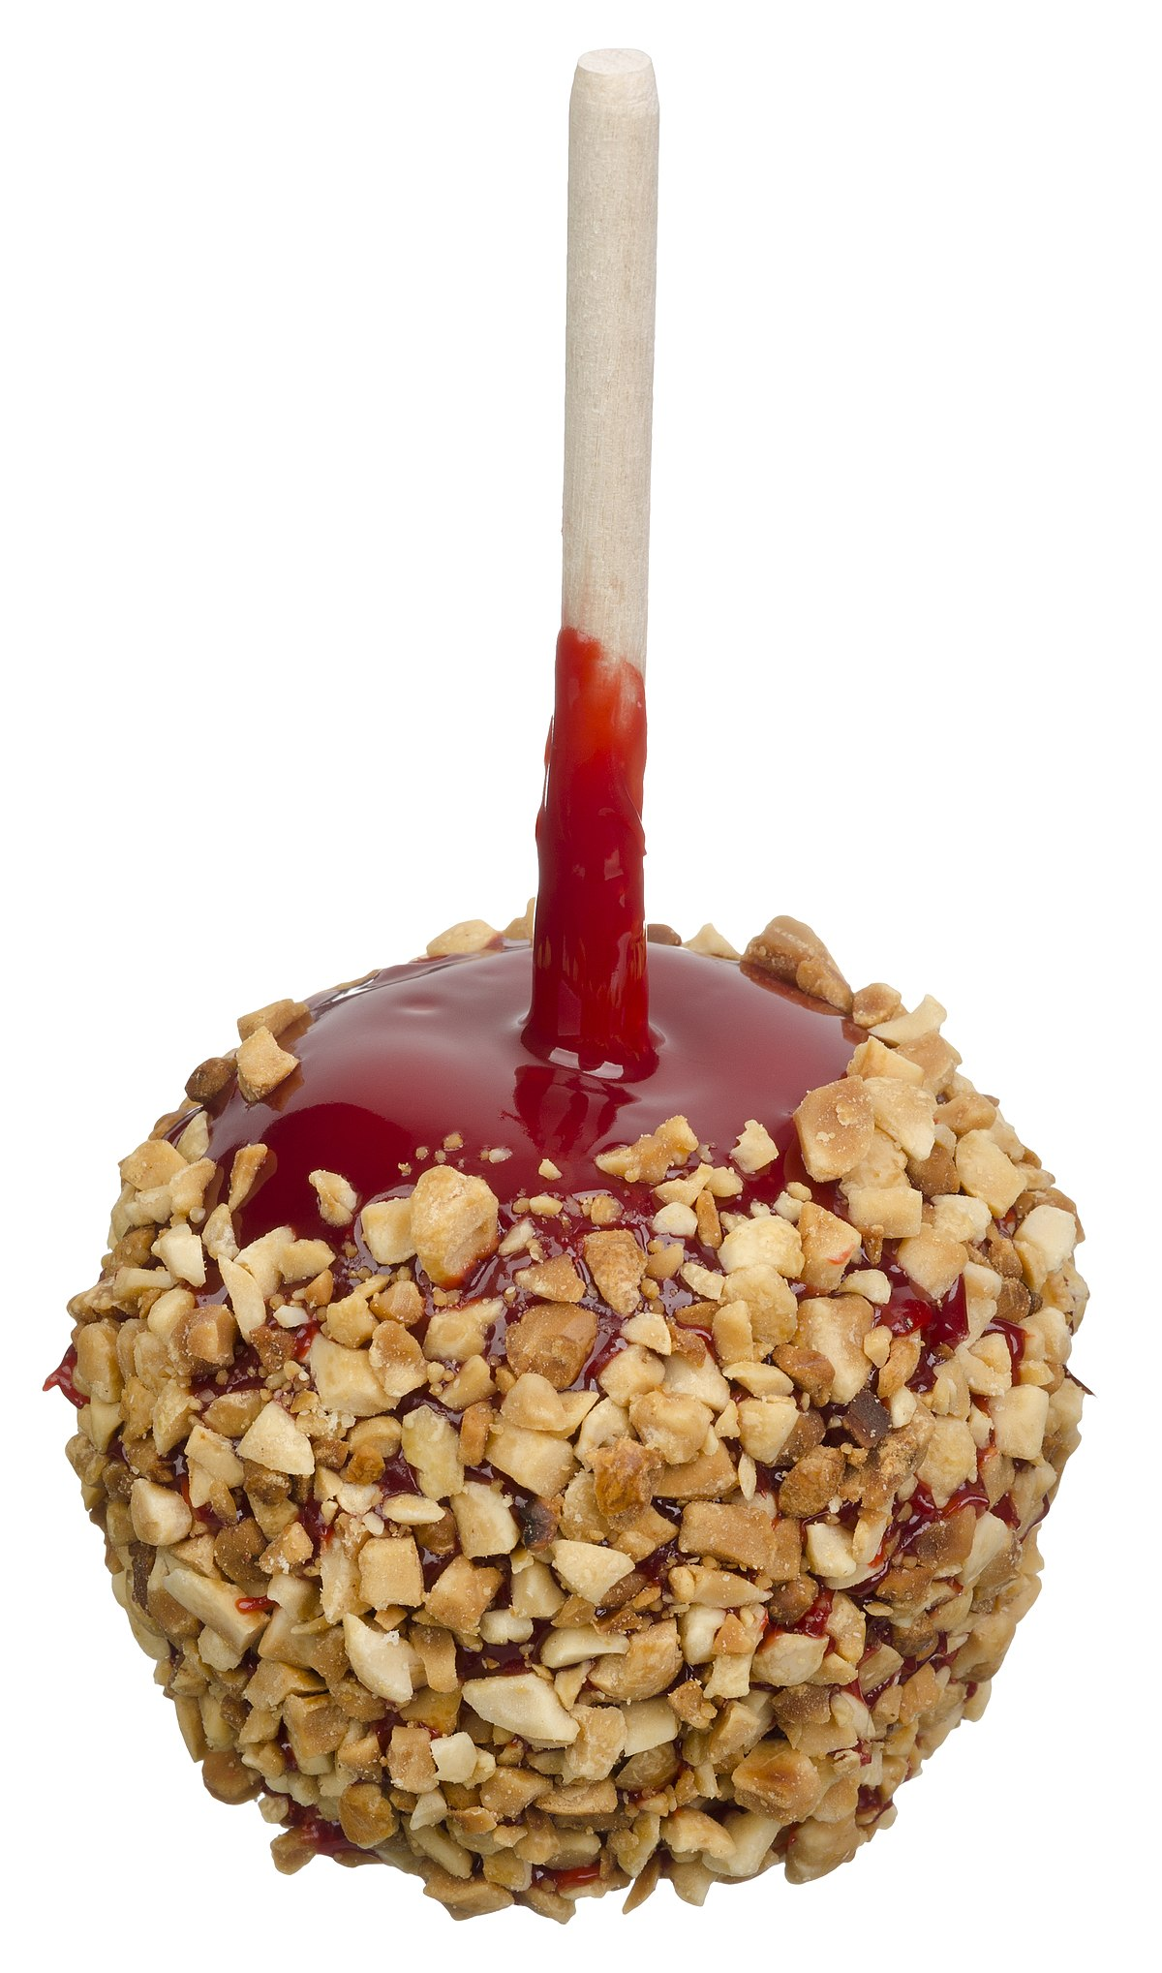
Candy or Caramel Apple
$ Pay $
4 Stretch up and Toe Touches
This Photo by Unknown Author is licensed under CC BY-SA
This Photo by Unknown Author is licensed under CC BY-SA

Slide 13
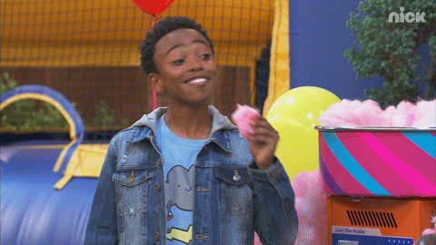
Cotton candy
$ Pay $
2 Push Ups
This Photo by Unknown Author is licensed under CC BY-SA
https://media1.giphy.com/media/65SmRRO19PsxBw2bqe/giphy.gif
This Photo by Unknown Author is licensed under CC BY-NC-ND

Slide 14
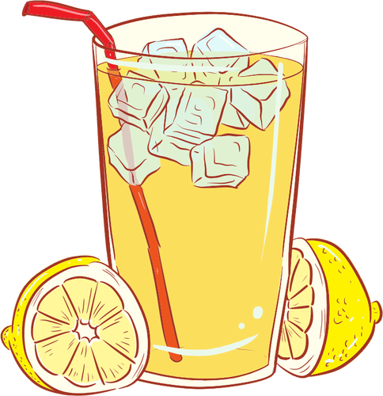
Lemonade
$ Pay $
3 Jumping Jacks

Slide 15
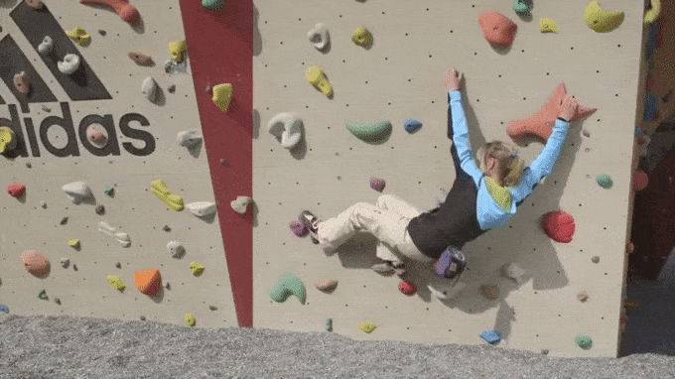
Rock Wall
https://media3.giphy.com/media/l3q2KgPyebeZ9G1uo/giphy.gif

Slide 16
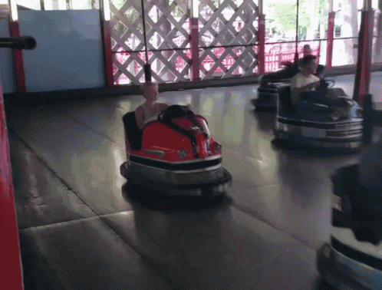
Bumper Cars
https://media1.tenor.com/images/ced6952a3e643b953800d11da3607499/tenor.gif?itemid=7305817

Slide 17
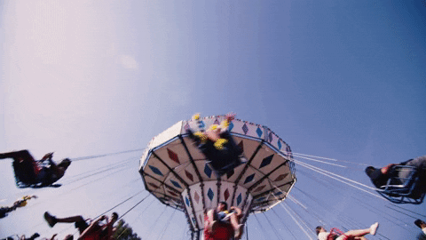
Screamer
https://media3.giphy.com/media/3o7aD46d4MNu68z70Y/giphy.gif

Slide 18
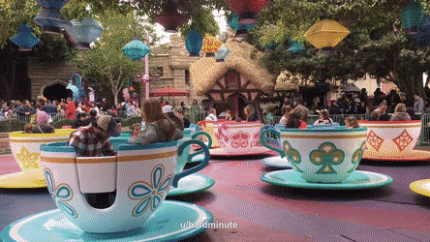
Tea Cups
https://www.google.com/url?sa=i&url=https%3A%2F%2Fwww.tigernet.com%2Fforum%2Fmessage%2FRe-If-our-basketball-program-was-an-amusement-park-ride-would-27232636&psig=AOvVaw18wRCh0QTyOgcjTIXJG98U&ust=1618259495143000&source=images&cd=vfe&ved=0CAIQjRxqFwoTCKCWpqOF9-8CFQAAAAAdAAAAABAD
Notes:
https://www.youtube.com/watch?v=kprlOVK16ck

Slide 19
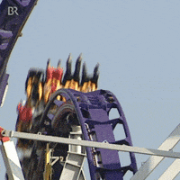
Ring of Fire
This Photo by Unknown Author is licensed under CC BY-SA
Create a craft of the
Ring of Fire ride!
https://media4.giphy.com/media/l0MYIBNl8SnEbt31K/200.gif

Slide 20
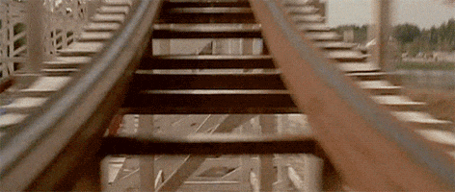
Rollercoaster
Draw a picture of a rollercoaster you would ride!

Slide 21
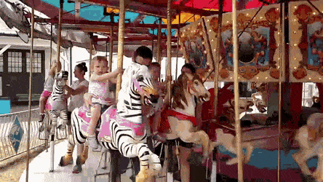
Carousel
Draw a horse and
cut it out
This Photo by Unknown Author is licensed under CC BY-SA
https://www.google.com/url?sa=i&url=https%3A%2F%2Fgfycat.com%2Fthickjoyfulbunting&psig=AOvVaw3d2LP_ByMwvbm1FC0bJPBM&ust=1618259947283000&source=images&cd=vfe&ved=0CAIQjRxqFwoTCMDX36WG9-8CFQAAAAAdAAAAABAV

Slide 22
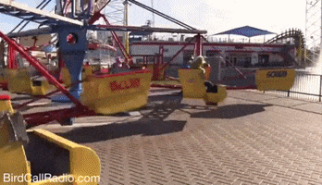
Scrambler
Spin 5 times!
This Photo by Unknown Author is licensed under CC BY-SA
https://www.google.com/url?sa=i&url=https%3A%2F%2Fgiphy.com%2Fgifs%2FdUUH5akgGwayz8Het1&psig=AOvVaw0np9MvqhzIX_N5Ji4G0fxx&ust=1618260436639000&source=images&cd=vfe&ved=0CAIQjRxqFwoTCNDDoYeI9-8CFQAAAAAdAAAAABAJ

Slide 23
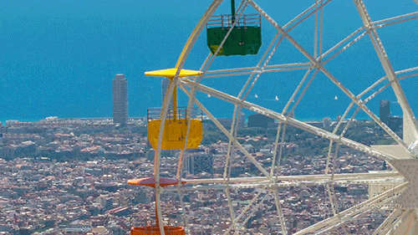
Ferris Wheel
Draw a Ferris Wheel!
This Photo by Unknown Author is licensed under CC BY-SA
https://www.google.com/url?sa=i&url=https%3A%2F%2Fwifflegif.com%2Ftags%2F15567-ferris-wheel-gifs&psig=AOvVaw3bV1HCfDAcgMfJ5ad8TcW6&ust=1618260730637000&source=images&cd=vfe&ved=0CAIQjRxqFwoTCJjvpZeJ9-8CFQAAAAAdAAAAABA7

Slide 24
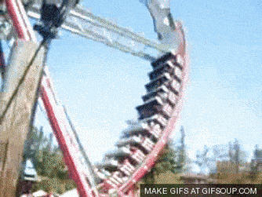
Pirate Ship
This Photo by Unknown Author is licensed under CC BY-SA
https://thumbs.gfycat.com/MemorableDefenselessCoyote-size_restricted.gif

Slide 25
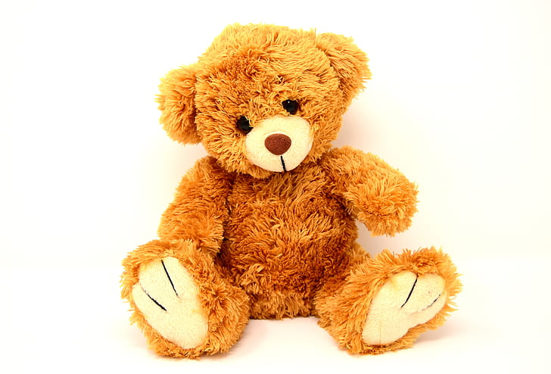
Balloon Pop: Share the link with the student or have the student tell you what cards to click on using directional terms. Link: https://www.thelearningapps.com/balloon-pops-ii/
This Photo by Unknown Author is licensed under CC BY-SA-NC

Slide 26
Memory Game Share the link with the student or have the student tell you what cards to click on using directional terms. Link: https://www.thelearningapps.com/birds-memory/
This Photo by Unknown Author is licensed under CC BY-SA-NC
This Photo by Unknown Author is licensed under CC BY-SA-NC

Slide 27
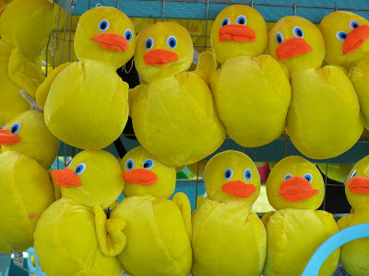
Duck Maze: Share link with student or have the student give you directional terms: right, left, up, and down to complete the maze. Link: https://www.happyclicks.net/maze-games/10-duck-maze.php
This Photo by Unknown Author is licensed under CC BY-SA-NC
This Photo by Unknown Author is licensed under CC BY-ND

Slide 28
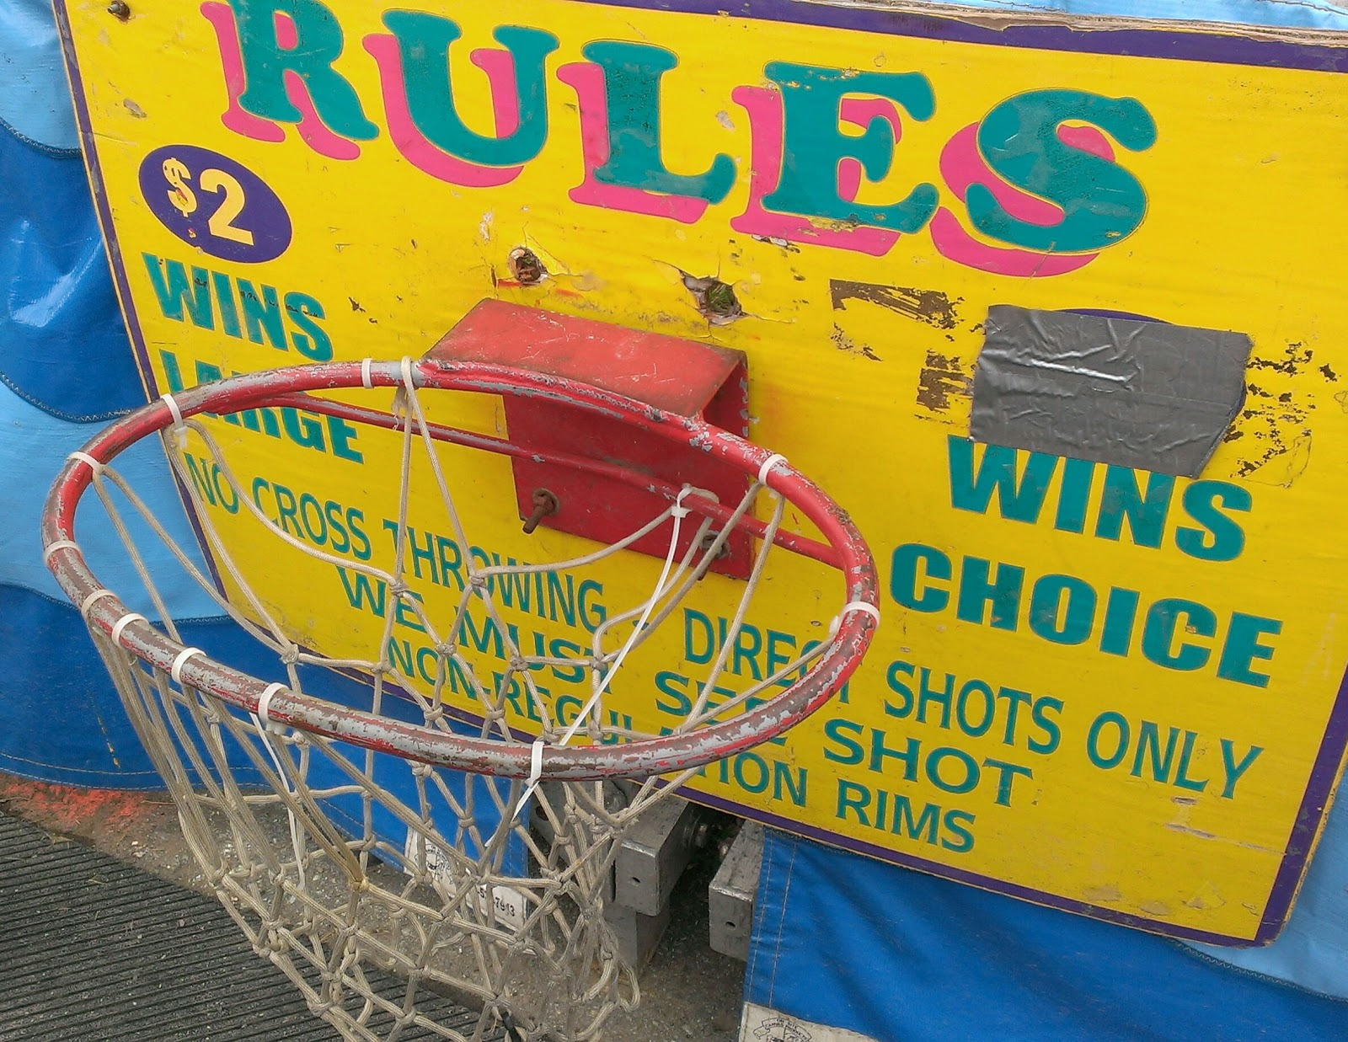
Basketball Shooting
Share link with student or have the student give you directional terms: right, left, up, and down to complete the maze.
Link:
https://www.abcya.com/games/ten_basket
This Photo by Unknown Author is licensed under CC BY-SA
This Photo by Unknown Author is licensed under CC BY
This Photo by Unknown Author is licensed under CC BY-NC

Slide 29
Spin the Wheel
Click on the wheel to spin and see what you win!
This is PRETEND!

