Slide 1
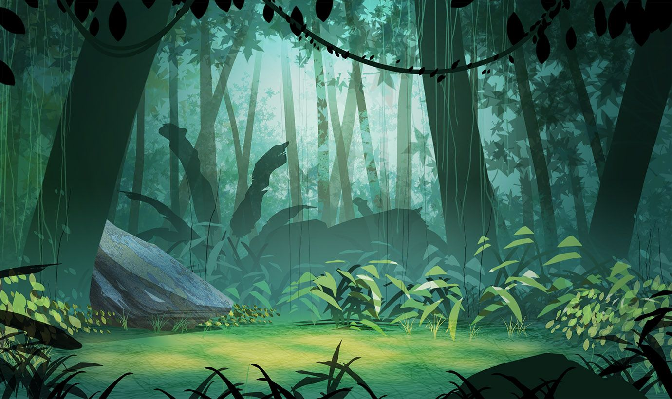
BABY DRAGONS!
Created and Designed by
Kim Wiggins, OTR/L
www.OTKimWiggins.com
Each slide contains credits for the graphics and sound effects in the NOTES section. Don’t forget to share your sound because the sound effects make this game even more fun!

Slide 2
Directions:
Enter the jungle to locate a dragon egg.
After the student locates the egg. In order to crack the egg the student must complete a task by spinning the wheel. Feel free to change the tasks using www.wheelofnames.com
Once the task is completed, click to see the egg hatch and click again to see a baby dinosaur appear. “Aww so cute!”
Click again and all of a sudden the dragon breathes fire! “YIKES!”
“How can we put out the fire?” Click again and a bucket of water balloons appears. Pretend to throw the balloon and click until it splats and the fire disappears!
On the last slide, all of the dragons appear and a HUGE fire ball appears. Instead of using water balloons we need to use something stronger to put out the fire!
HAVE FUN!

Slide 3
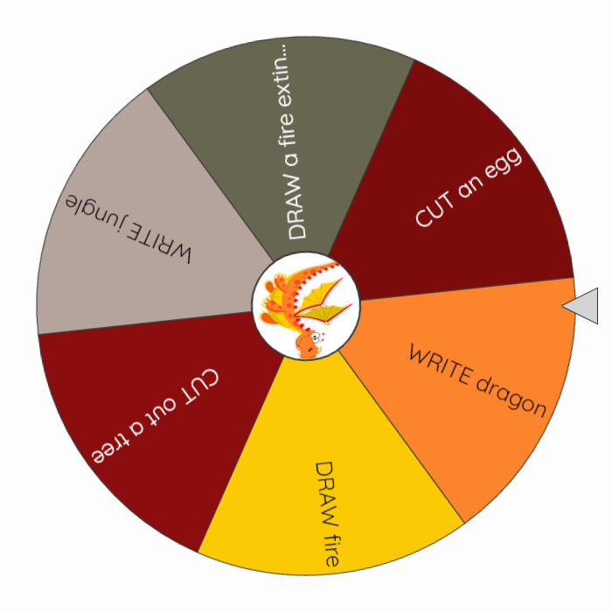
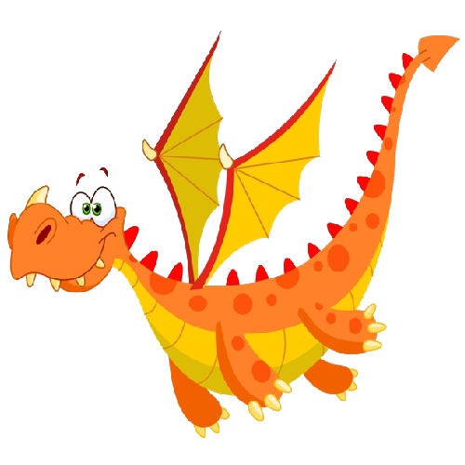
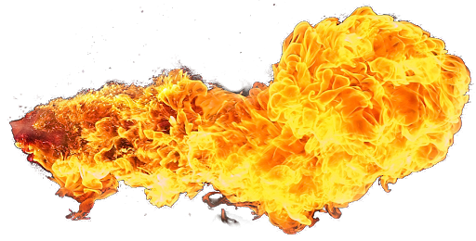
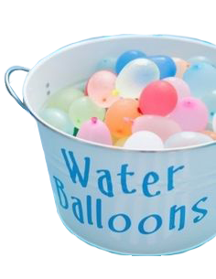
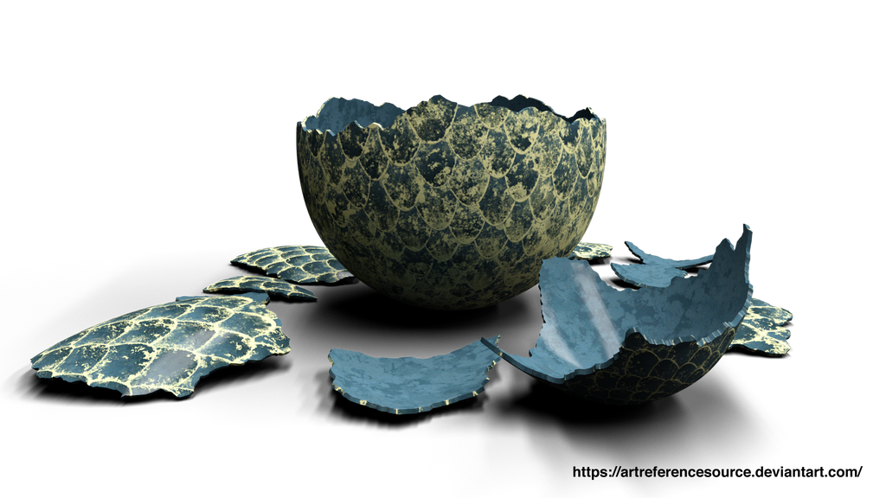
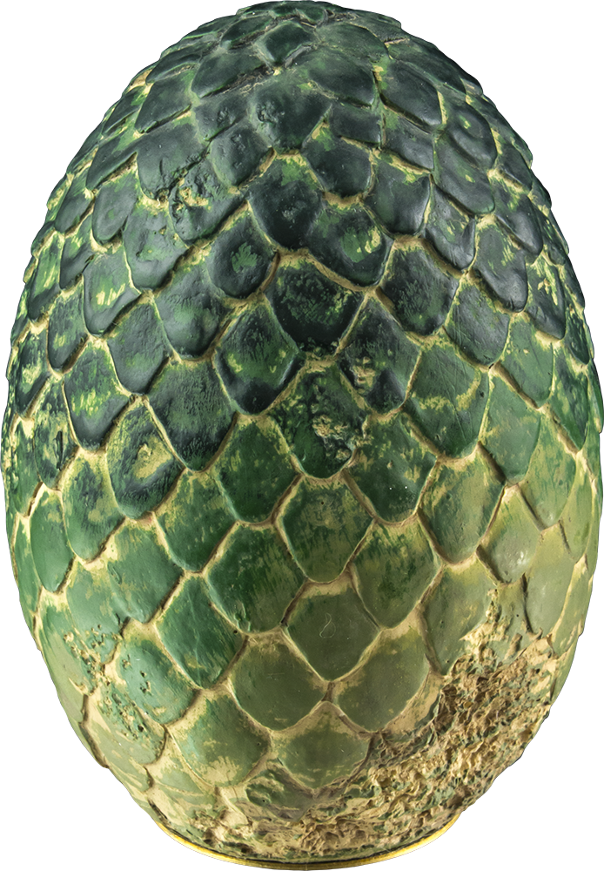
Notes:
Alternative for the spinner: Writing sentences: https://wheelofnames.com/ep4-duh
https://wheelofnames.com/m96-8h3
https://images.app.goo.gl/ASrBGMKPVRVGHb219
Cracked dragon egg: https://www.deviantart.com/artreferencesource/art/Stock-PNG-Cracked-Dragon-Egg-716778612
Egg: https://www.dlf.pt/ddetail/ToJibR_dragon-egg-game-of-thrones-png-transparent-png/
Orange dragon: https://images.app.goo.gl/L8JCYJN1TuaJbP4E6
Dragon fire: http://www.pngmart.com/image/182053
Water balloon https://www.hiclipart.com/free-transparent-background-png-clipart-qyuiz/download
Water splash graphic: https://www.clipartmax.com/middle/m2i8G6i8G6i8m2i8_clip-art-pictures-water-splash-cartoon-png/
Sound effects from ZapSplat.com

Slide 4
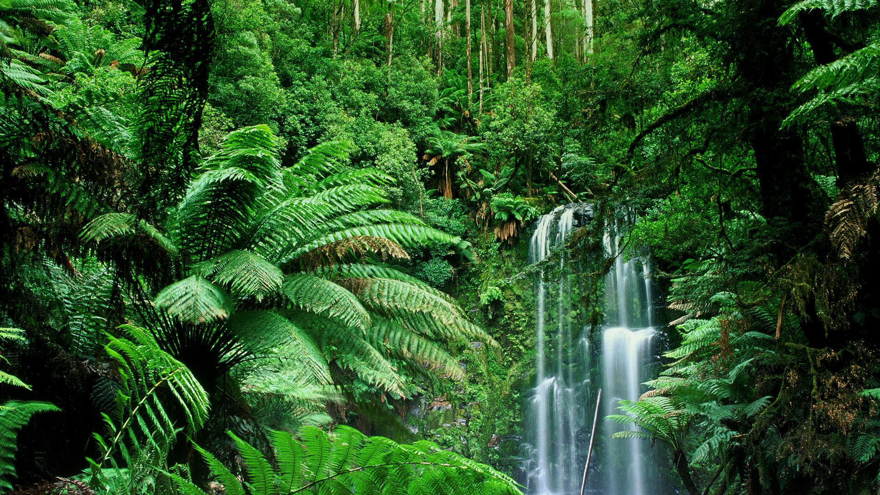
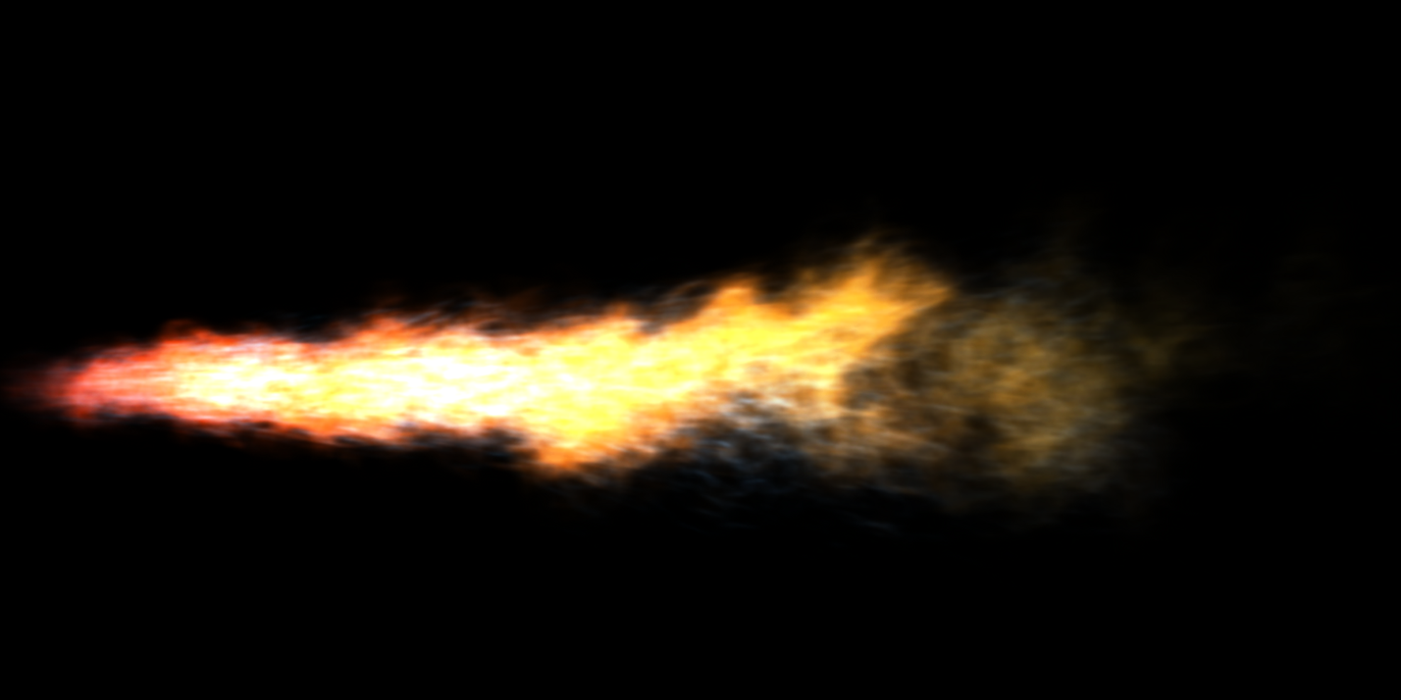
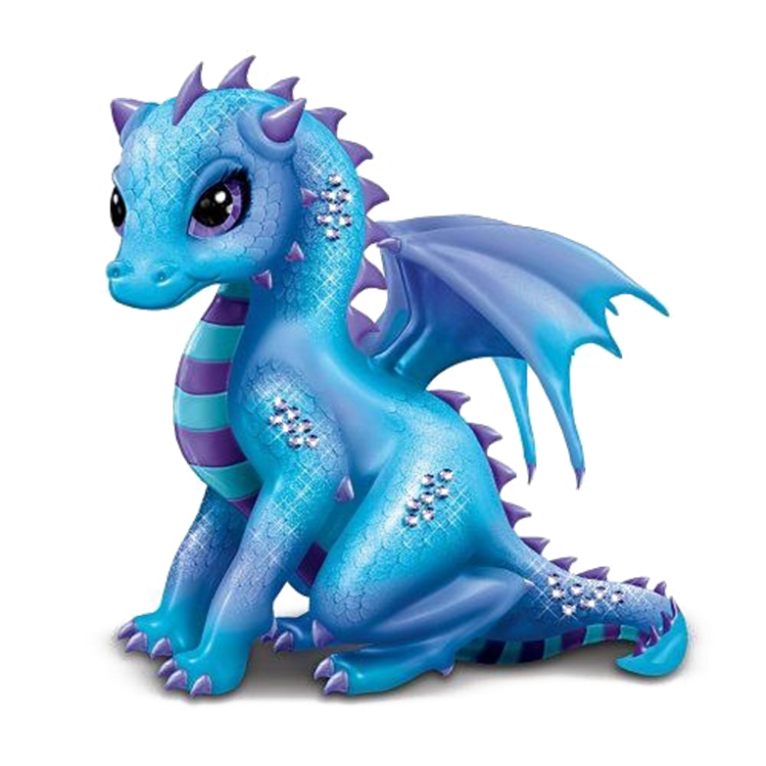
Notes:
https://images.app.goo.gl/ASrBGMKPVRVGHb219
Cracked dragon egg: https://www.deviantart.com/artreferencesource/art/Stock-PNG-Cracked-Dragon-Egg-716778612
Egg: https://www.dlf.pt/ddetail/ToJibR_dragon-egg-game-of-thrones-png-transparent-png/
Orange dragon: https://images.app.goo.gl/L8JCYJN1TuaJbP4E6
Dragon fire: http://www.pngmart.com/image/182053
Sound effects from ZapSplat.com

Slide 5
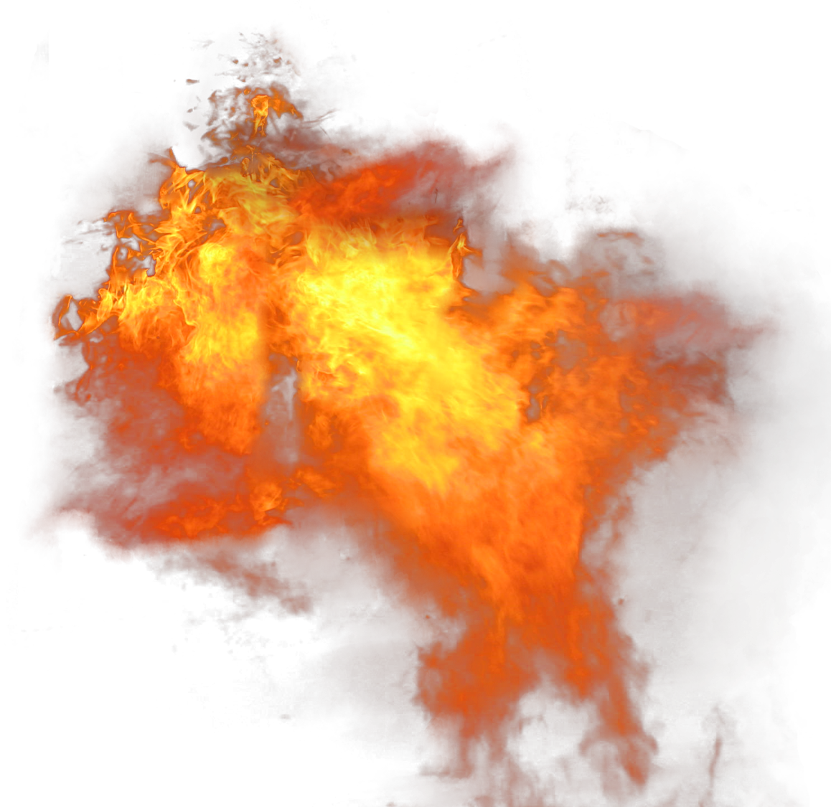
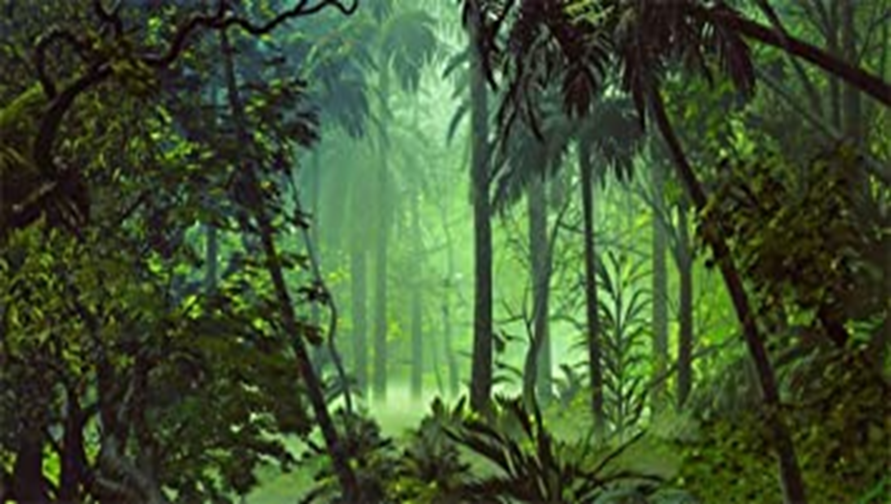
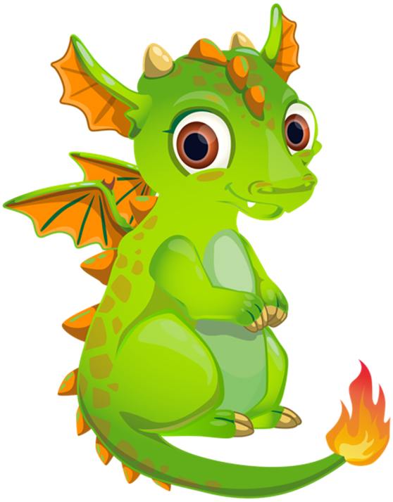
Notes:
https://images.app.goo.gl/ASrBGMKPVRVGHb219
Cracked dragon egg: https://www.deviantart.com/artreferencesource/art/Stock-PNG-Cracked-Dragon-Egg-716778612
Egg: https://www.dlf.pt/ddetail/ToJibR_dragon-egg-game-of-thrones-png-transparent-png/
Orange dragon: https://images.app.goo.gl/L8JCYJN1TuaJbP4E6
Dragon fire: http://www.pngmart.com/image/182053
Sound effects from ZapSplat.com

Slide 6
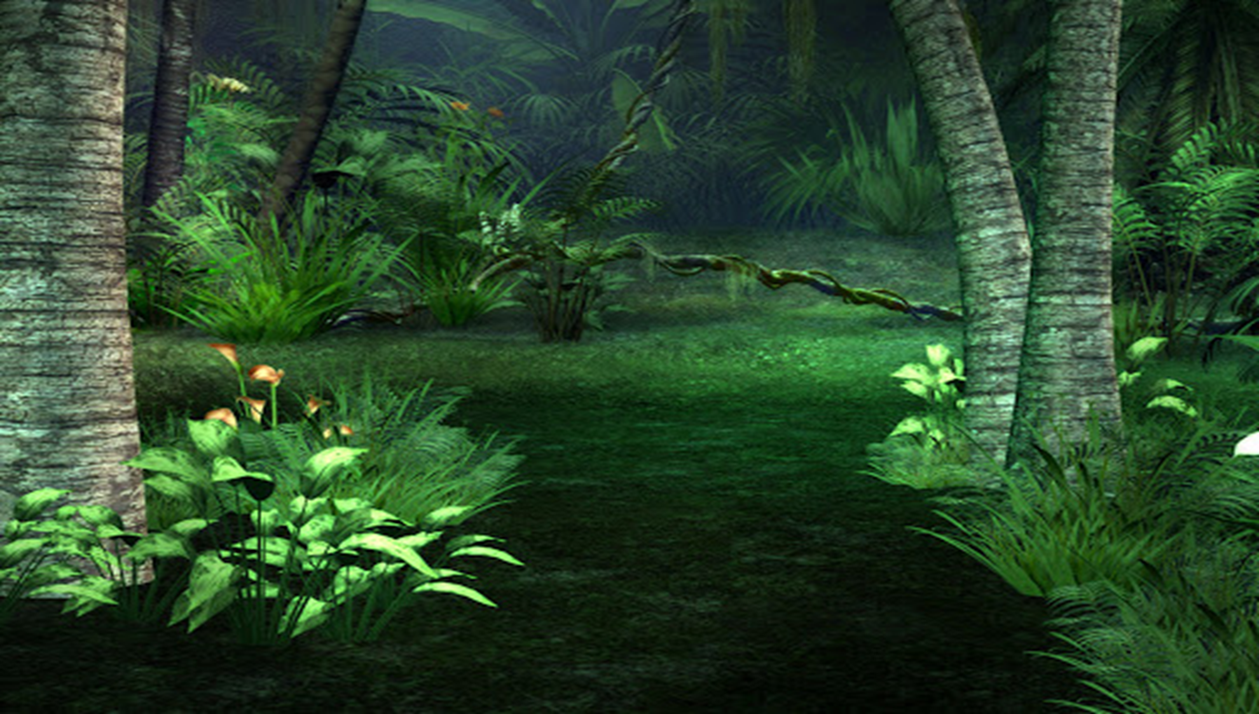
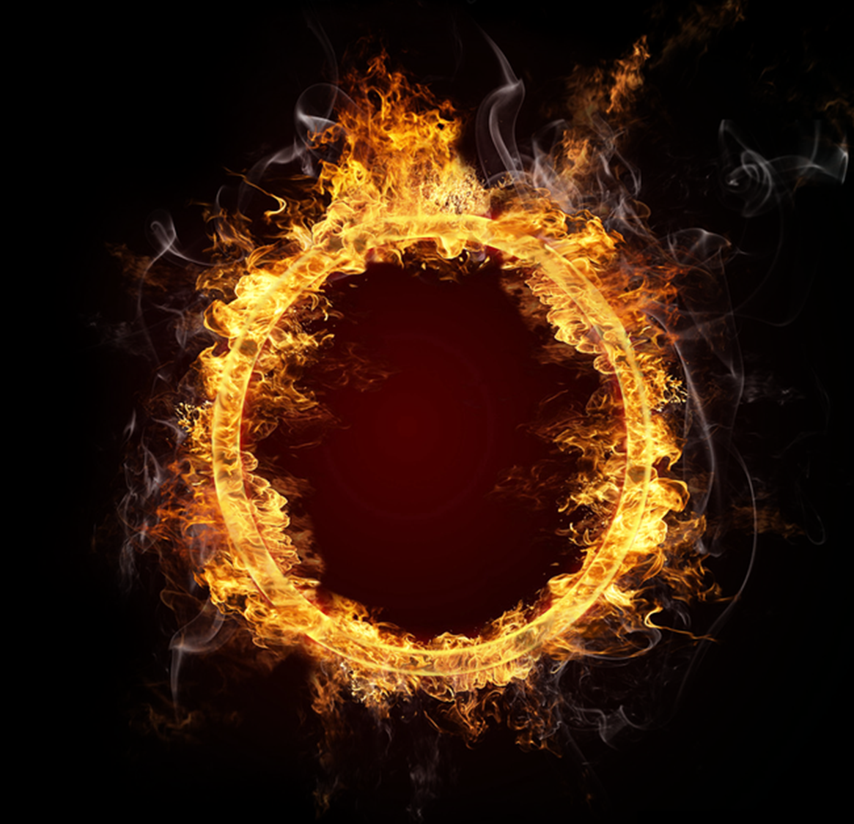
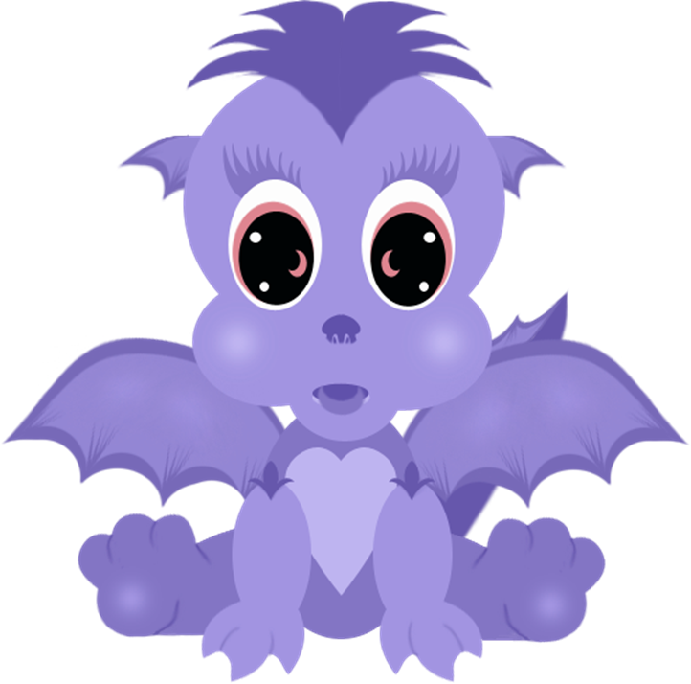
Notes:
https://images.app.goo.gl/rwezgQy9HxUsDmty5
Cracked dragon egg: https://www.deviantart.com/artreferencesource/art/Stock-PNG-Cracked-Dragon-Egg-716778612
Egg: https://www.dlf.pt/ddetail/ToJibR_dragon-egg-game-of-thrones-png-transparent-png/
Orange dragon: https://images.app.goo.gl/L8JCYJN1TuaJbP4E6
Dragon fire: http://www.pngmart.com/image/182053
Sound effects from ZapSplat.com

Slide 7
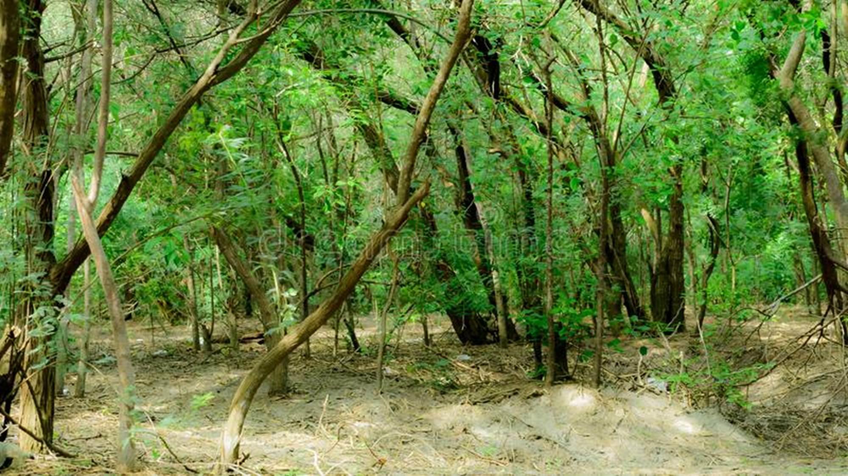
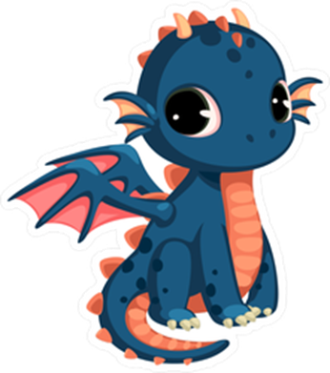
Notes:
https://images.app.goo.gl/ASrBGMKPVRVGHb219
Cracked dragon egg: https://www.deviantart.com/artreferencesource/art/Stock-PNG-Cracked-Dragon-Egg-716778612
Egg: https://www.dlf.pt/ddetail/ToJibR_dragon-egg-game-of-thrones-png-transparent-png/
Dark blue dragon: https://images.app.goo.gl/r3PFxZJsiBJ5zXok9
Fire: https://www.hiclipart.com/free-transparent-background-png-clipart-iczba
Fire extinguisher: https://gfycat.com/stickers/search/fire+extinguisher
Sound effects from ZapSplat.com

Slide 8
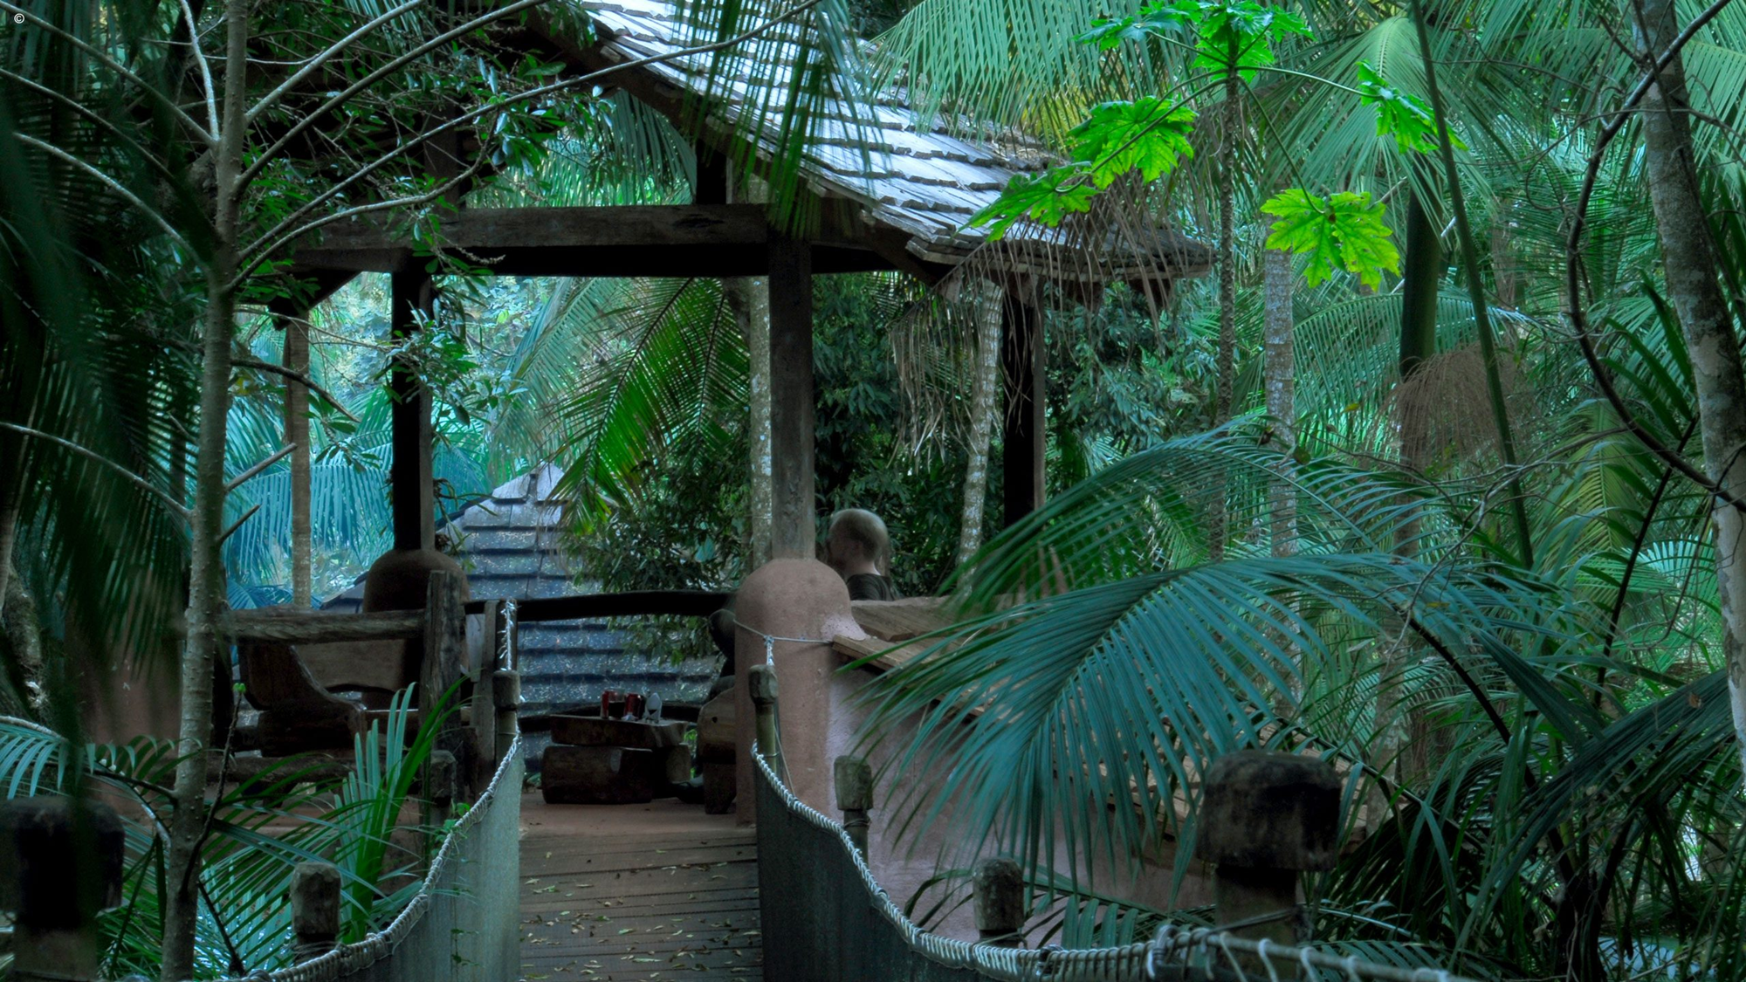
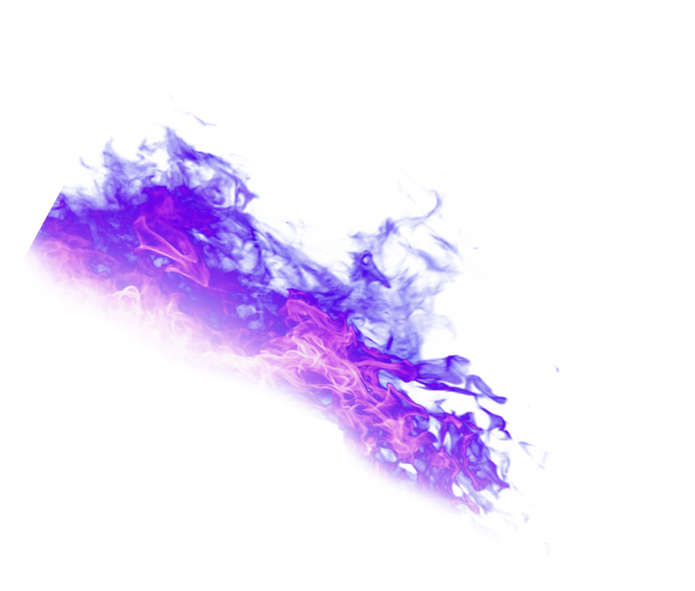
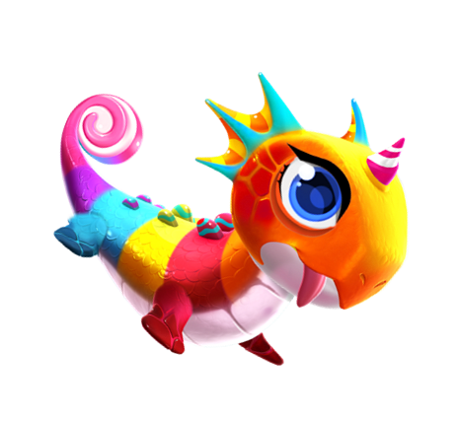
Notes:
https://images.app.goo.gl/ASrBGMKPVRVGHb219
Cracked dragon egg: https://www.deviantart.com/artreferencesource/art/Stock-PNG-Cracked-Dragon-Egg-716778612
Egg: https://www.dlf.pt/ddetail/ToJibR_dragon-egg-game-of-thrones-png-transparent-png/
Rainbow dragon: https://www.pngfind.com/download/ToJxom_candy-dragon-baby-dragon-mania-legends-baby-dragons/
Fire: https://www.hiclipart.com/free-transparent-background-png-clipart-ipylh
Sound effects from ZapSplat.com

Slide 9
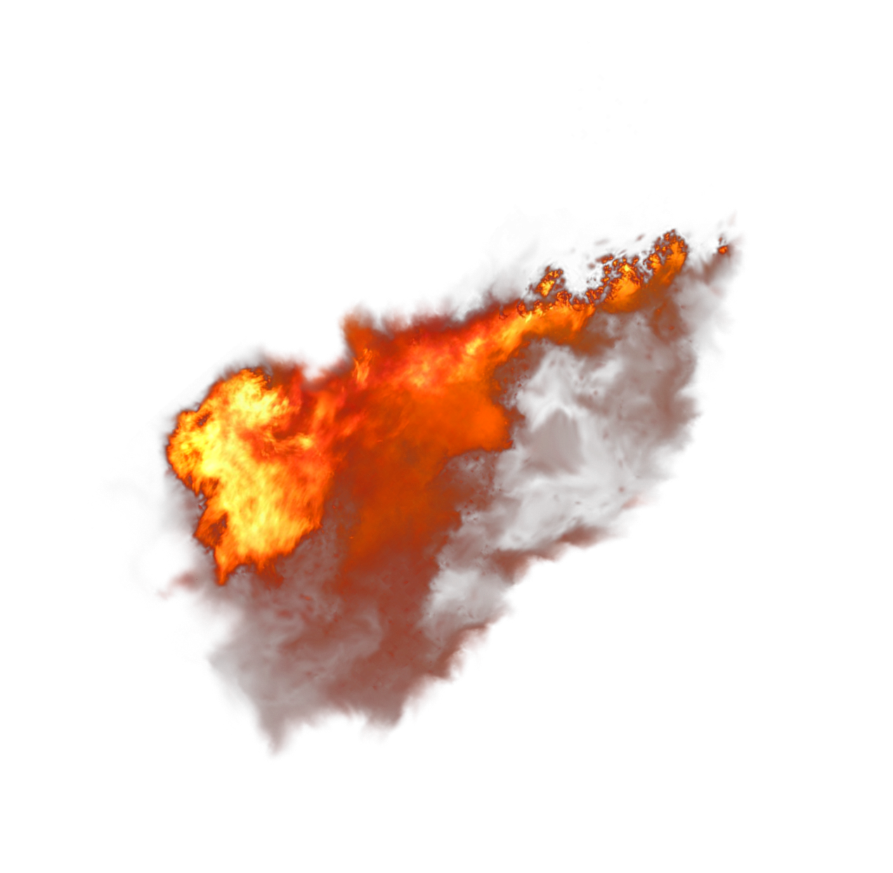
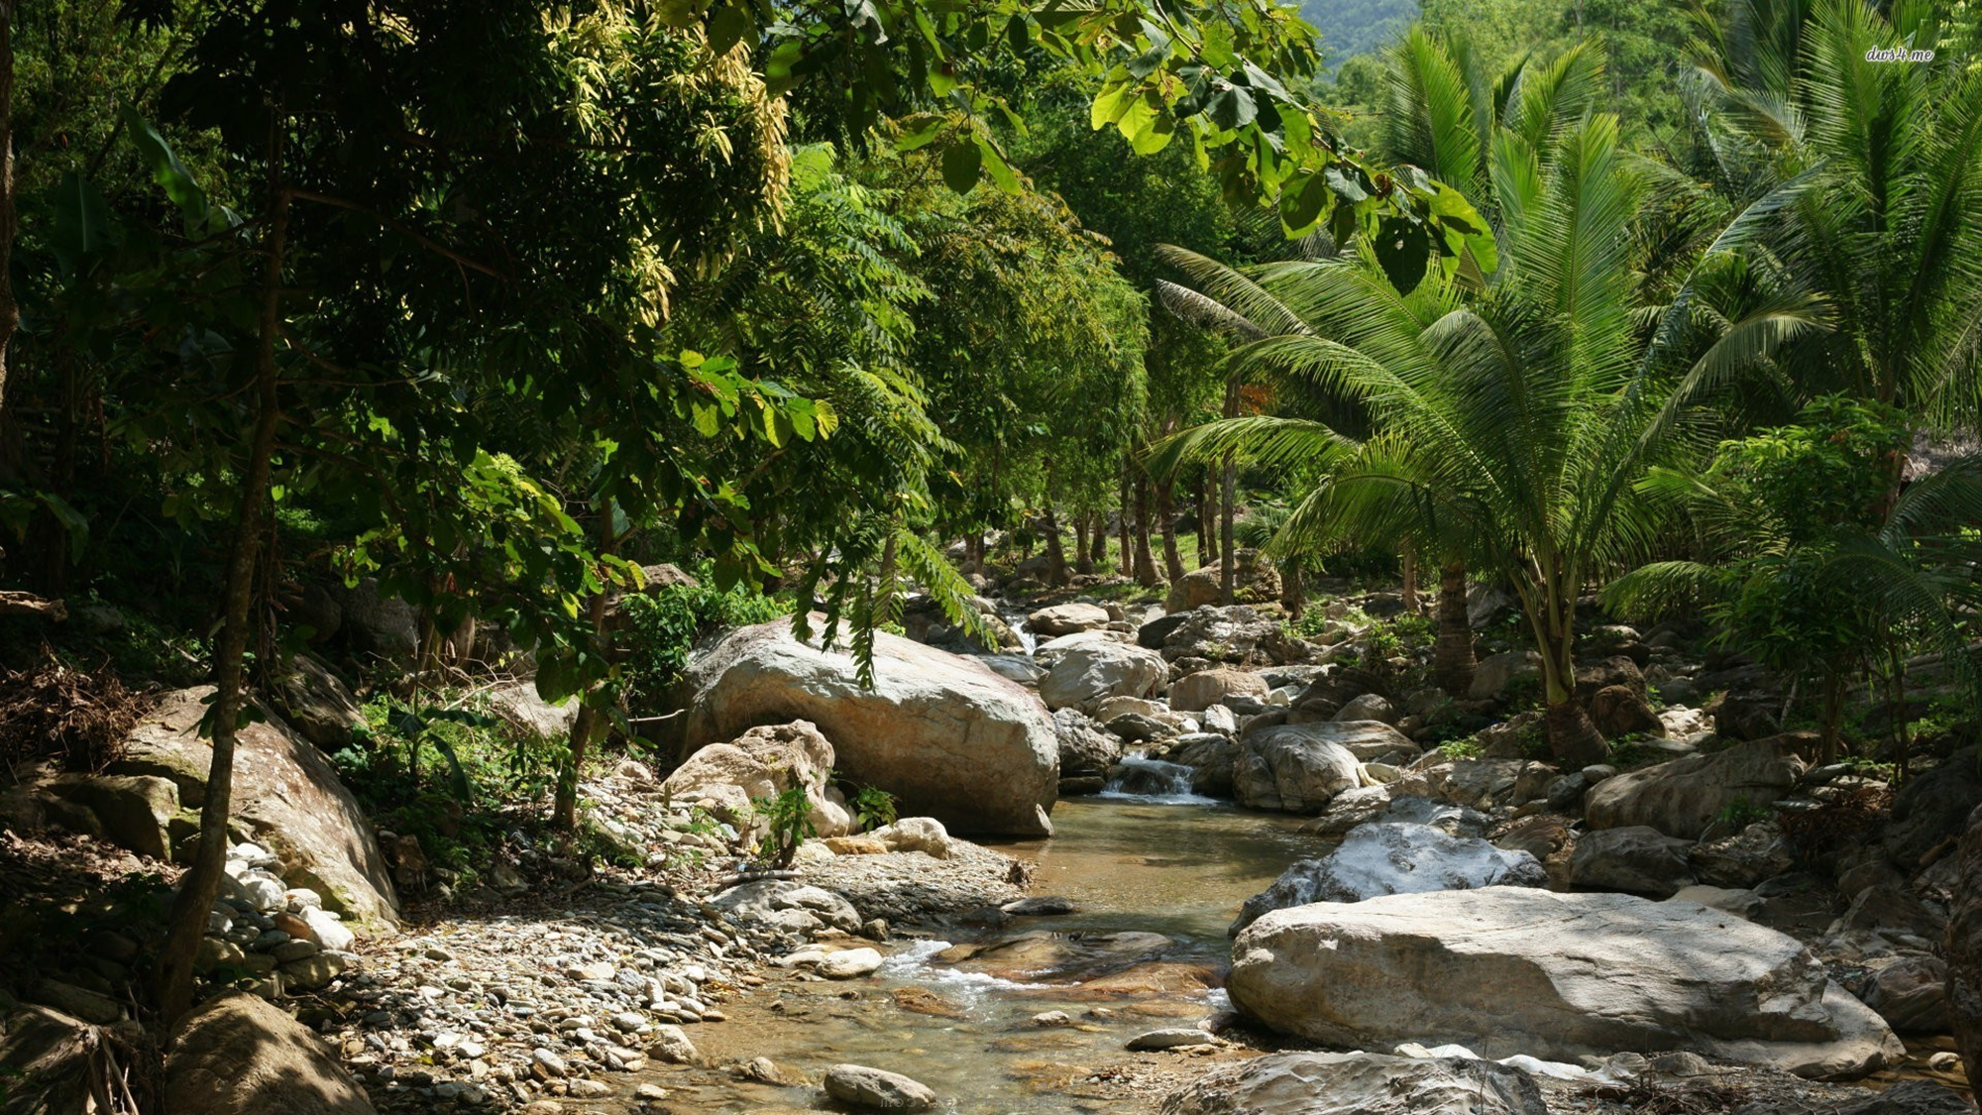
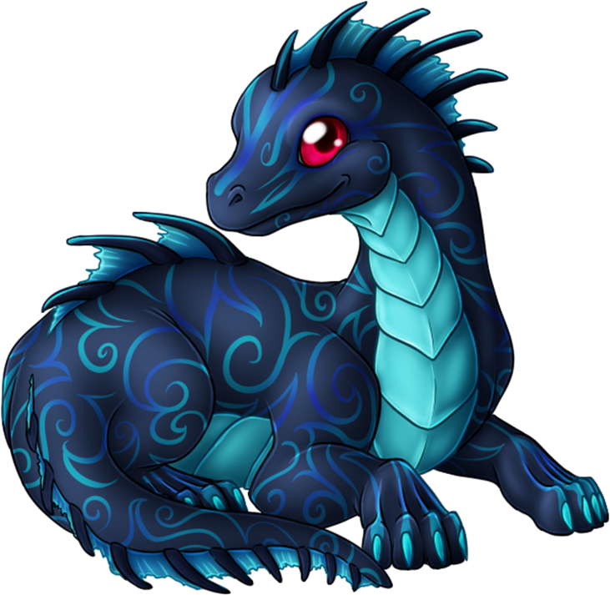
Notes:
Background https://images.app.goo.gl/akFsmmdKQ6hTwVqj9
Fire: https://www.hiclipart.com/free-transparent-background-png-clipart-qmpmd
Cracked dragon egg: https://www.deviantart.com/artreferencesource/art/Stock-PNG-Cracked-Dragon-Egg-716778612
Egg: https://www.dlf.pt/ddetail/ToJibR_dragon-egg-game-of-thrones-png-transparent-png/
Rainbow dragon: https://www.pngfind.com/download/ToJxom_candy-dragon-baby-dragon-mania-legends-baby-dragons/
Sound effects from ZapSplat.com

Slide 10
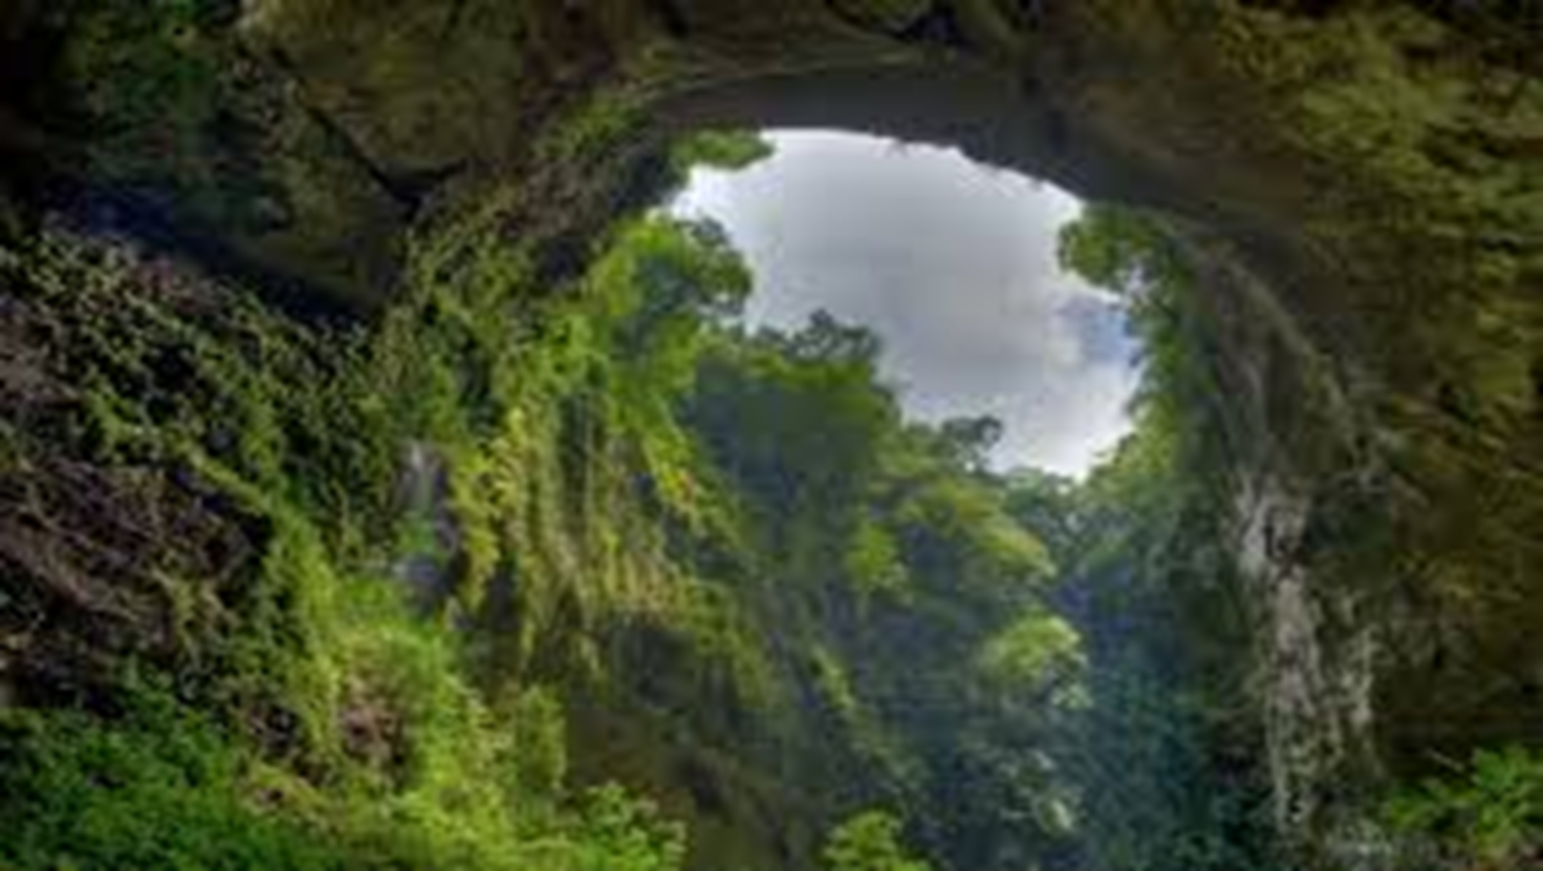
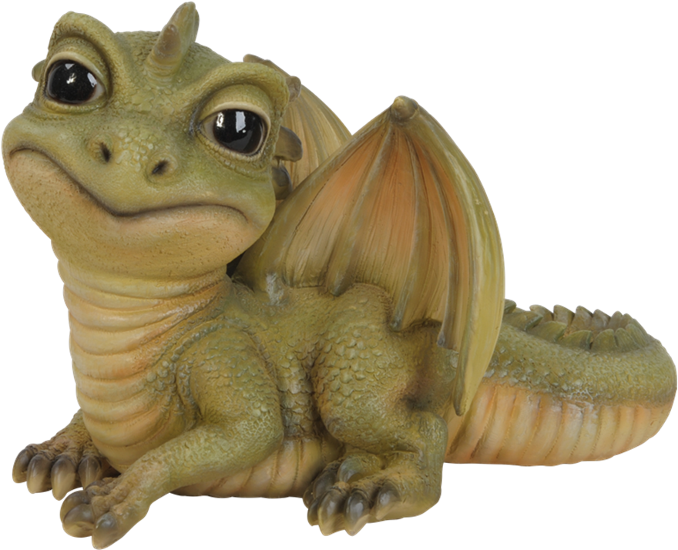
Notes:
https://images.app.goo.gl/Mj2LFfjvqGdHBqYT6
Dragon: https://www.pngfind.com/download/hmRbobw_small-image-of-pet-pal-baby-green-dragon/
Fire: https://www.hiclipart.com/free-transparent-background-png-clipart-qmpmd
Cracked dragon egg: https://www.deviantart.com/artreferencesource/art/Stock-PNG-Cracked-Dragon-Egg-716778612
Egg: https://www.dlf.pt/ddetail/ToJibR_dragon-egg-game-of-thrones-png-transparent-png/
Sound effects from ZapSplat.com

Slide 11
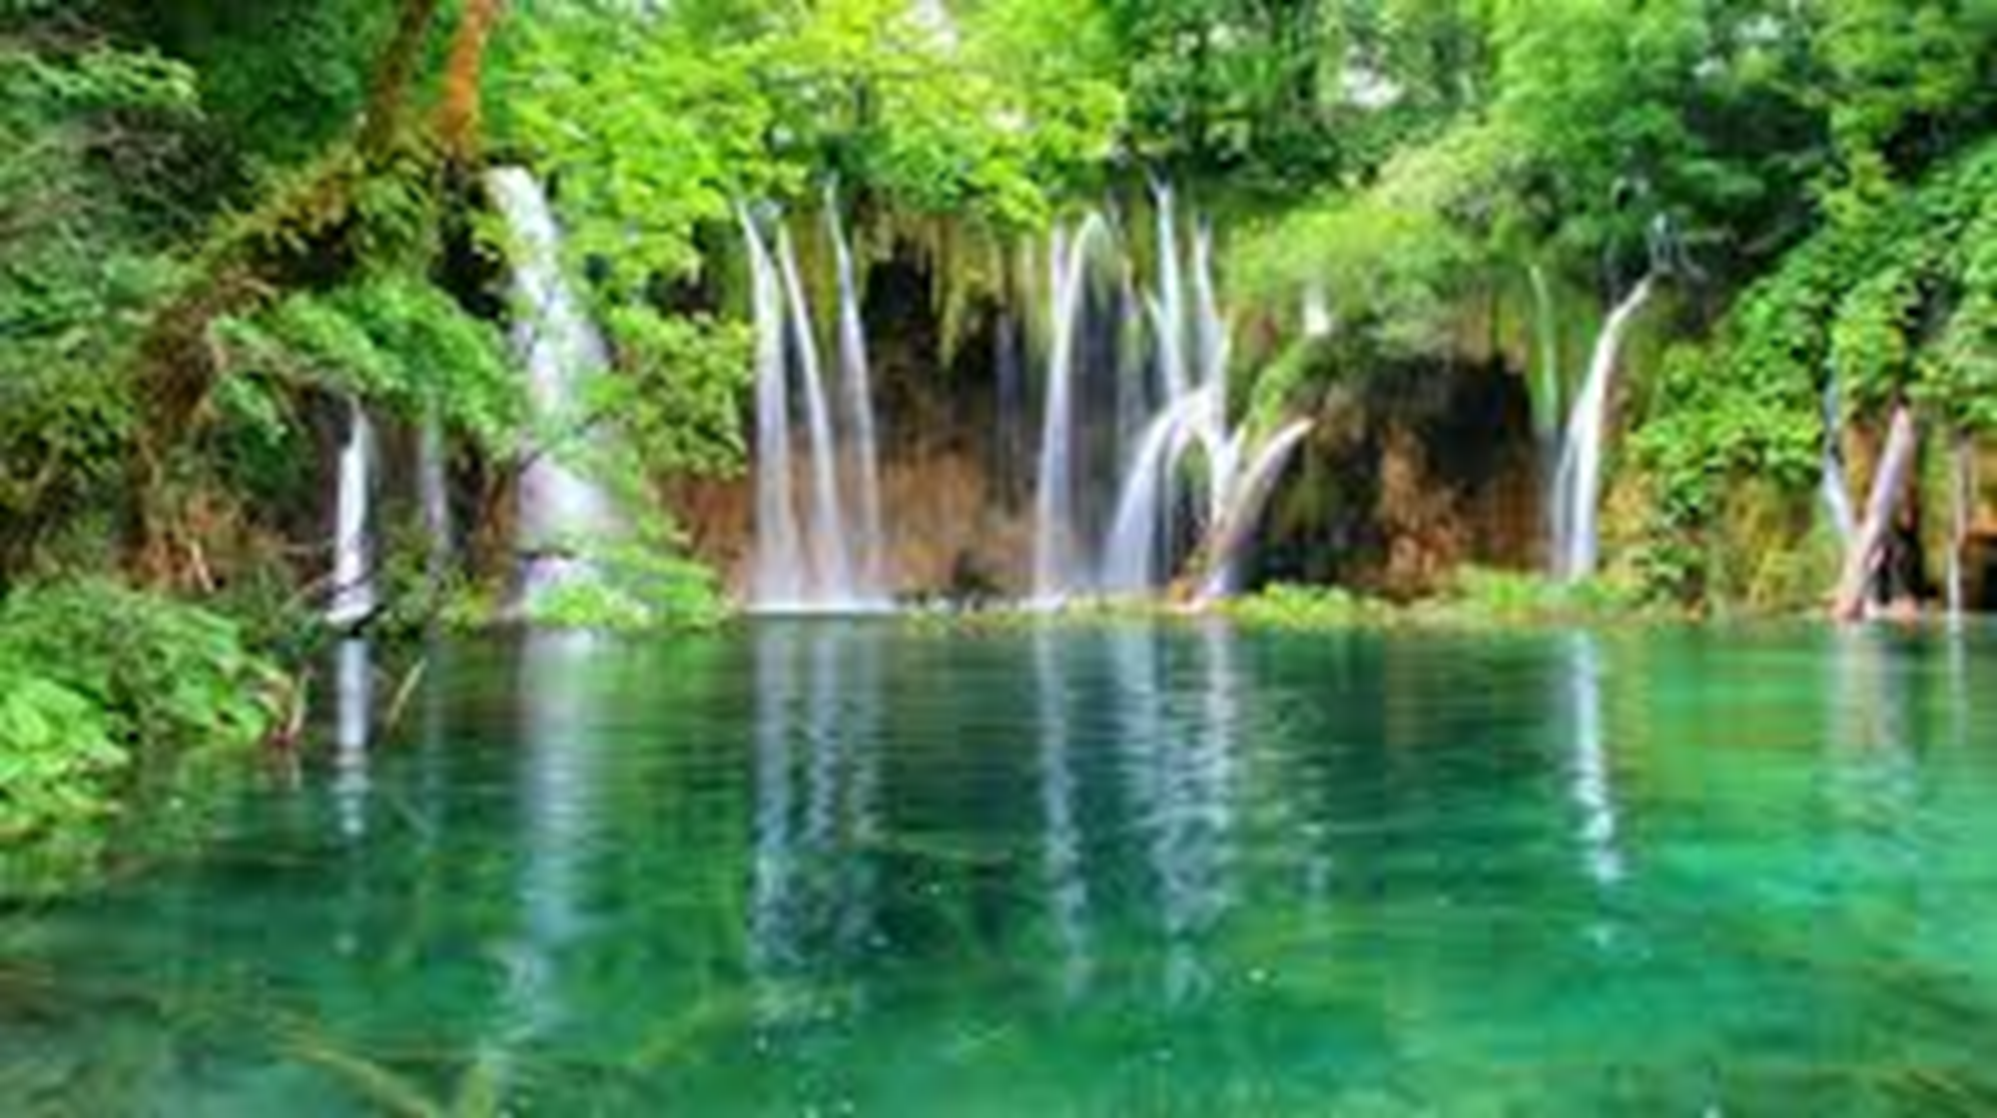
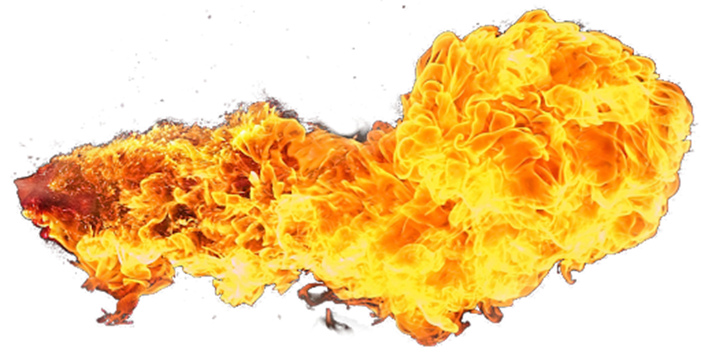
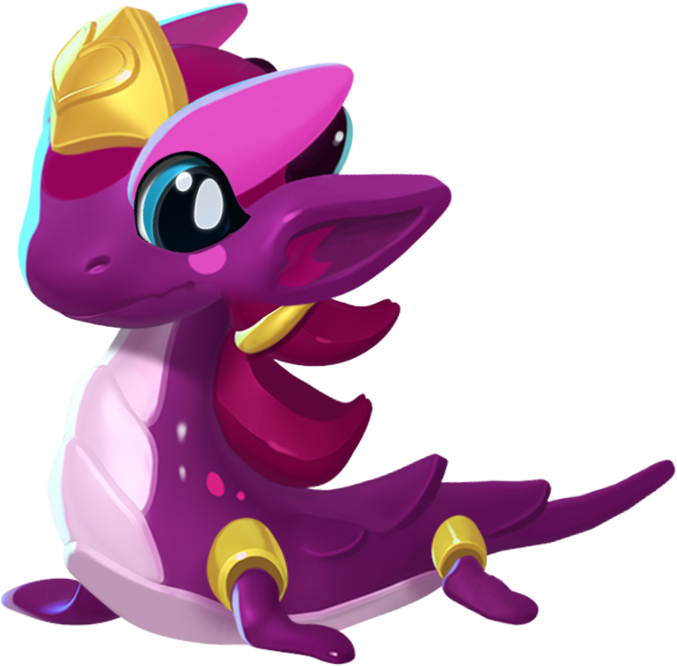
Notes:
https://images.app.goo.gl/PXg8q96h9keitXnc7
Princess dragon: https://www.pngfind.com/download/iJxbhxh_princess-dragon-baby-dragon-de-princesa-dragon-mania/
Fire: https://www.hiclipart.com/free-transparent-background-png-clipart-qmpmd
Cracked dragon egg: https://www.deviantart.com/artreferencesource/art/Stock-PNG-Cracked-Dragon-Egg-716778612
Egg: https://www.dlf.pt/ddetail/ToJibR_dragon-egg-game-of-thrones-png-transparent-png/
Sound effects from ZapSplat.com

Slide 12
