Slide 1
Created by Kim Wiggins, OT www.OTKimWiggins.com

Slide 2
Among Us Character Images downloaded from https://www.citypng.com/ Sound Effects downloaded from https://www.voicy.network/pages/among-us Images downloaded from Google Images

Slide 3
Directions:
Share your screen. There are animations and sound effects that are very motivating to the students. Therefore, it is not as much fun to use it as a virtual background.
Open the PowerPoint and present the slide show starting from slide 4. Click to progress the slides until you get to the map.
Once you are on the map ask the students what room they would like to go to. Click on the icon for that room.
ROOMS:
Task Rooms: Click once to make the imposter walk to the task. Then click on the task picture. Choose a task from the list. Click on the task and it will take you to the specific task. You can modify the tasks to meet the needs of your students. When you are done click on the map to enter a new room.
Crewmate Rooms: Click once to make the imposter walk to the crewmate. Click 2nd time to “tag” the crewmate. Click 3rd time for the crewmate to disappear. We are replacing “killing” with “tagging.” Then click on the map in the upper right corner to choose a new room.
Victory VS Defeat: There are 2 small red character boxes on the bottom left of each screen.
When you have completed all of the tasks, click on the top one to show the VICTORY page.
If you run out of time or the tasks were not completed accurately, click on the bottom to show the DEFEAT page.
DON’T FORGET to turn on your computer sound when you share your screen on ZOOM!

Slide 4
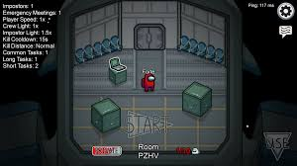
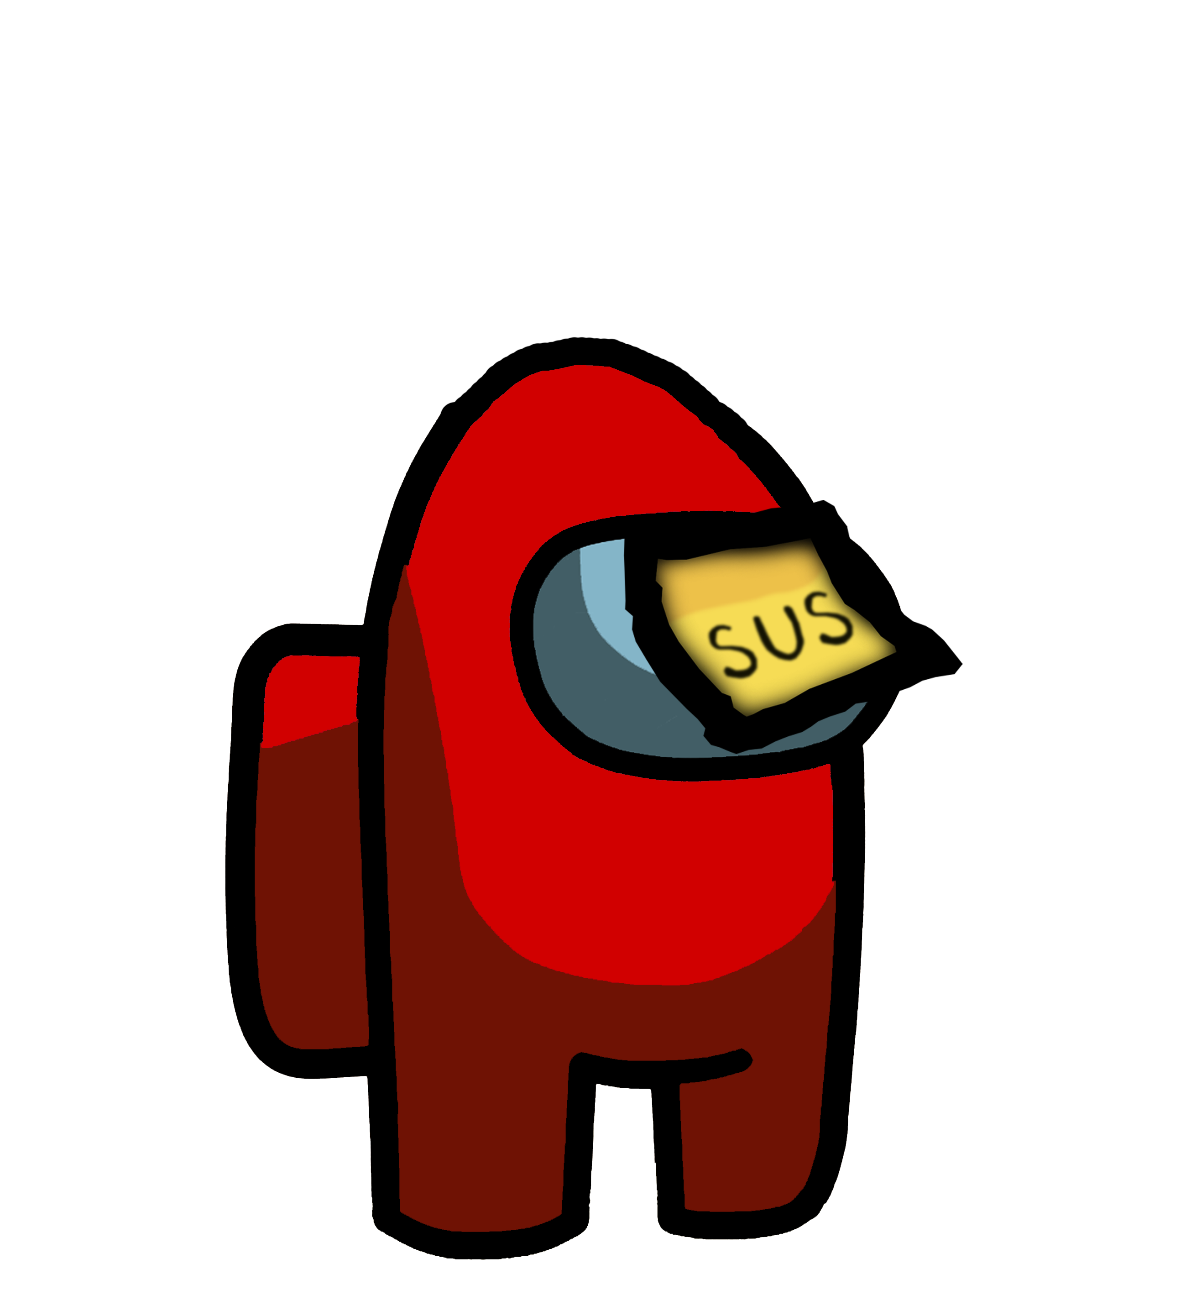
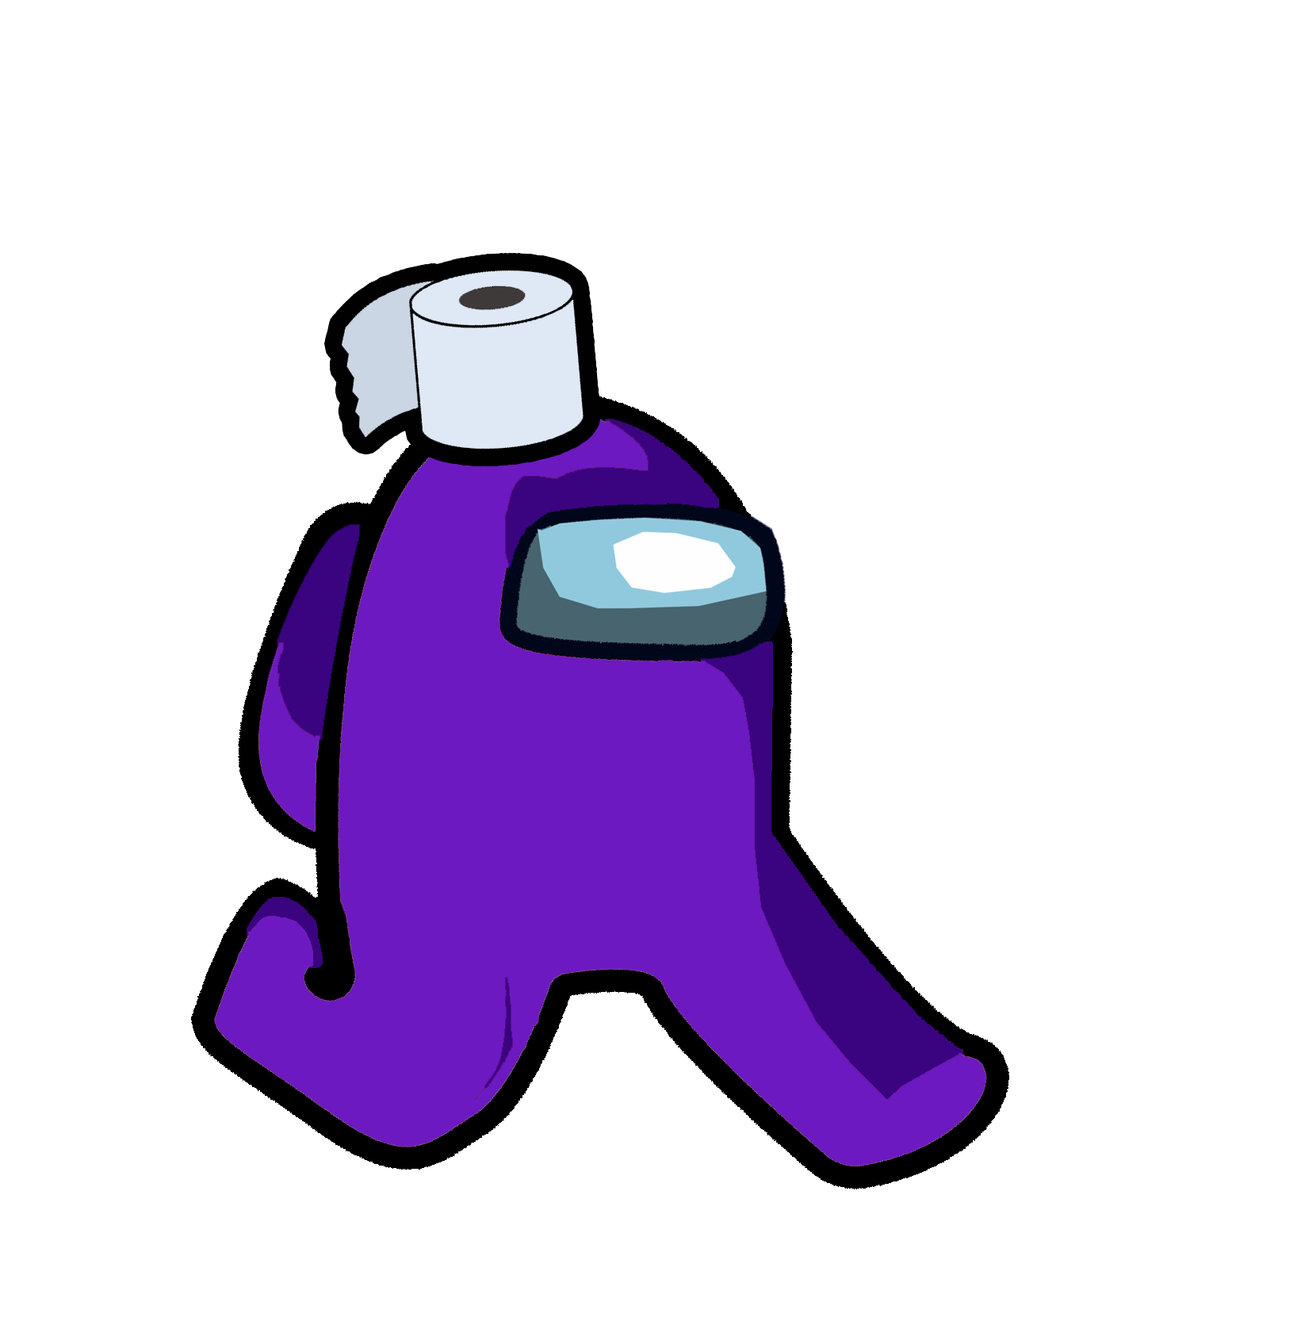

Slide 7
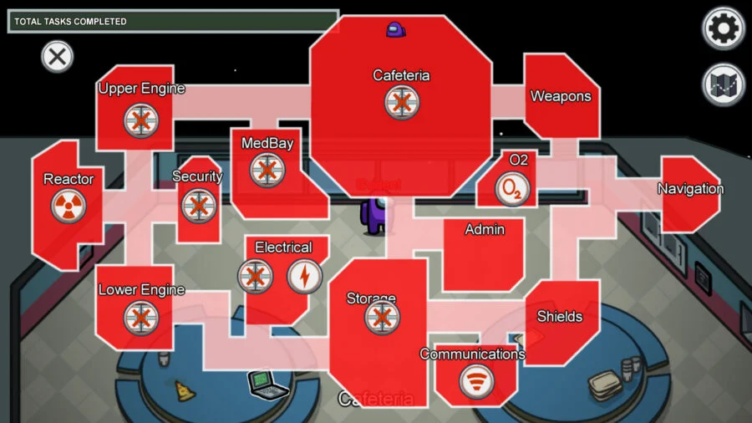
X

Slide 8
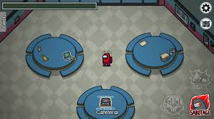
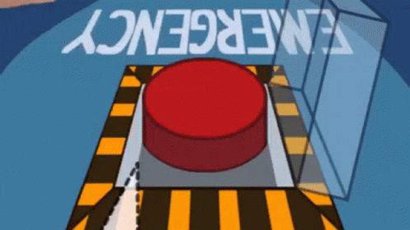
Cafeteria
Click here
This Photo by Unknown Author is licensed under CC BY-NC-ND

Slide 9
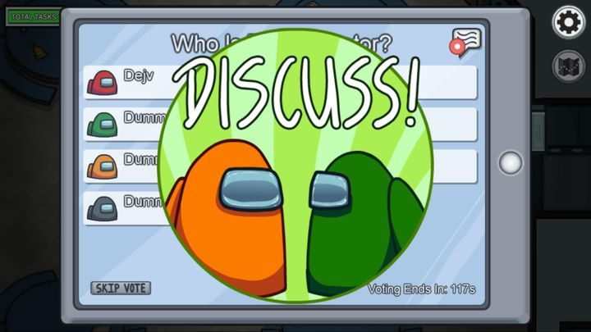
Emergency Meeting
WRITE: I suspect ___________________

Slide 10
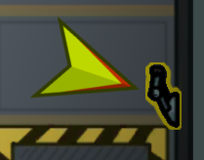
TASK
TASK 1
TASK 5
TASK 2
TASK 6
TASK 3
TASK 7
TASK 4
Notes:
Actual Among Us Tasks: https://among-us.fandom.com/wiki/Tasks

Slide 11
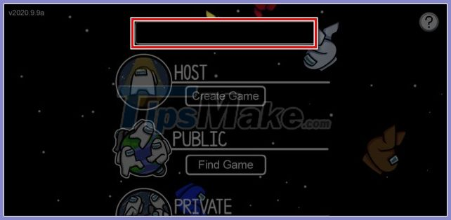
TASK 1
Write the name of your character using appropriate letter sizing and placement on the line.
https://among-us.fandom.com/wiki/Tasks
Notes:
https://www.youtube.com/watch?v=ra3zHOYlG2c
Among Us Origami

Slide 12
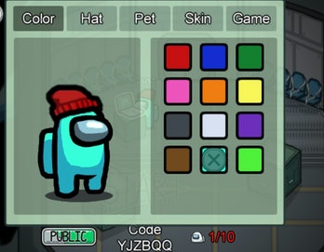
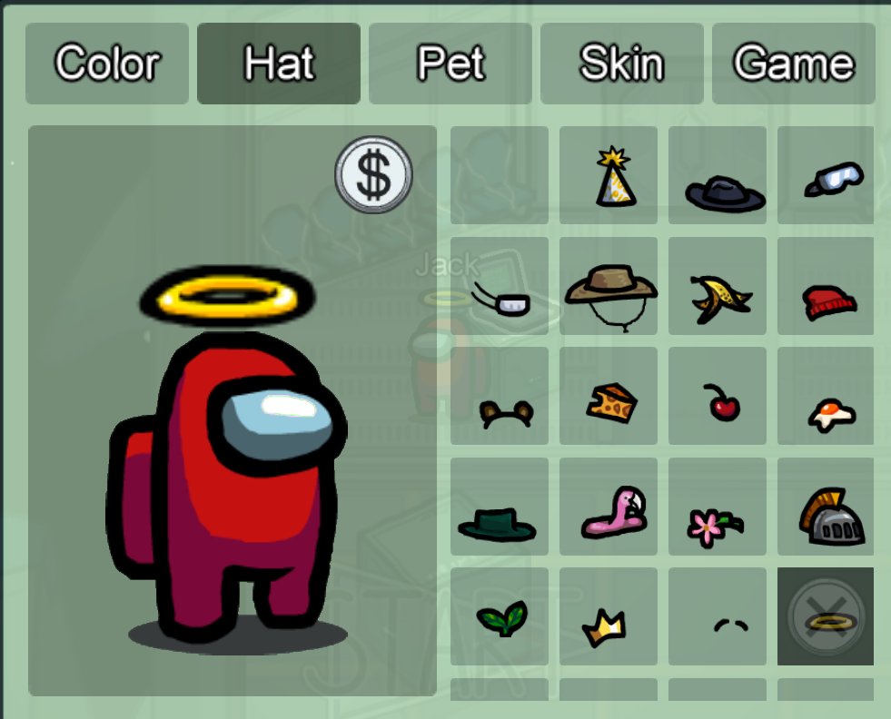
TASK 2
Draw a picture of your character and cut it out. Add a hat!
Video tutorial:
https://www.youtube.com/watch?v=SEWzbVhAR2U

Slide 13
TASK 3
Directions:
There are 3 levels of difficulty.
Spot the differences.
Medium starts at 3:30
Hard starts at 6:47
How many did you get correct?
Notes:
https://www.youtube.com/watch?v=Fj2rT9yLJ08
Spot the match on both sides.
Do the exercise for the one you think it is.
How many did you get correct?

Slide 14
TASK 4
Directions:
This video is 4 minutes.
Play until you guess an imposter correctly!
Notes:
Alternate option: https://www.youtube.com/watch?v=7Bnduy-Oy24

Slide 15
TASK 5
Directions:
This video is 3 minutes and 10 seconds.
Notes:
https://www.youtube.com/watch?v=7Bnduy-Oy24
https://www.youtube.com/watch?v=rHYnSkDtA30
https://www.youtube.com/watch?v=RfYSSM_AuUo

Slide 16
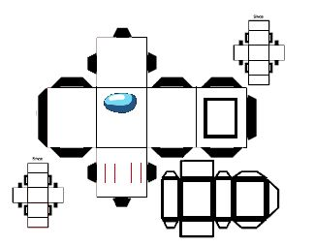
TASK 6
Directions:
Draw a map with 5-6 squares and label them with your favorite rooms.
Notes:
Alternate option:
4 corners exercise game:
https://www.youtube.com/watch?v=RfYSSM_AuUo

Slide 17
TASK 7
Directions:
There are 4 rounds and a bonus level. Choose a round.
Round 1: fast forward to 0:42
Round 2: fast forward to 2:43
Round 3: fast forward to 4:48
Round 4: fast forward to 6:51
Bonus: fast forward to 9:02

Slide 18
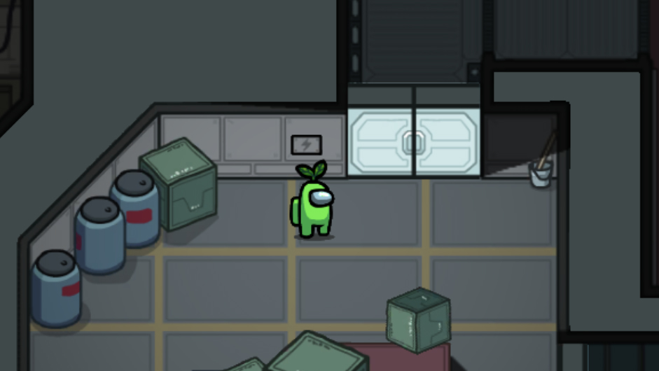
Storage
Notes:
https://www.youtube.com/watch?v=qahMJ5GDRNk

Slide 19
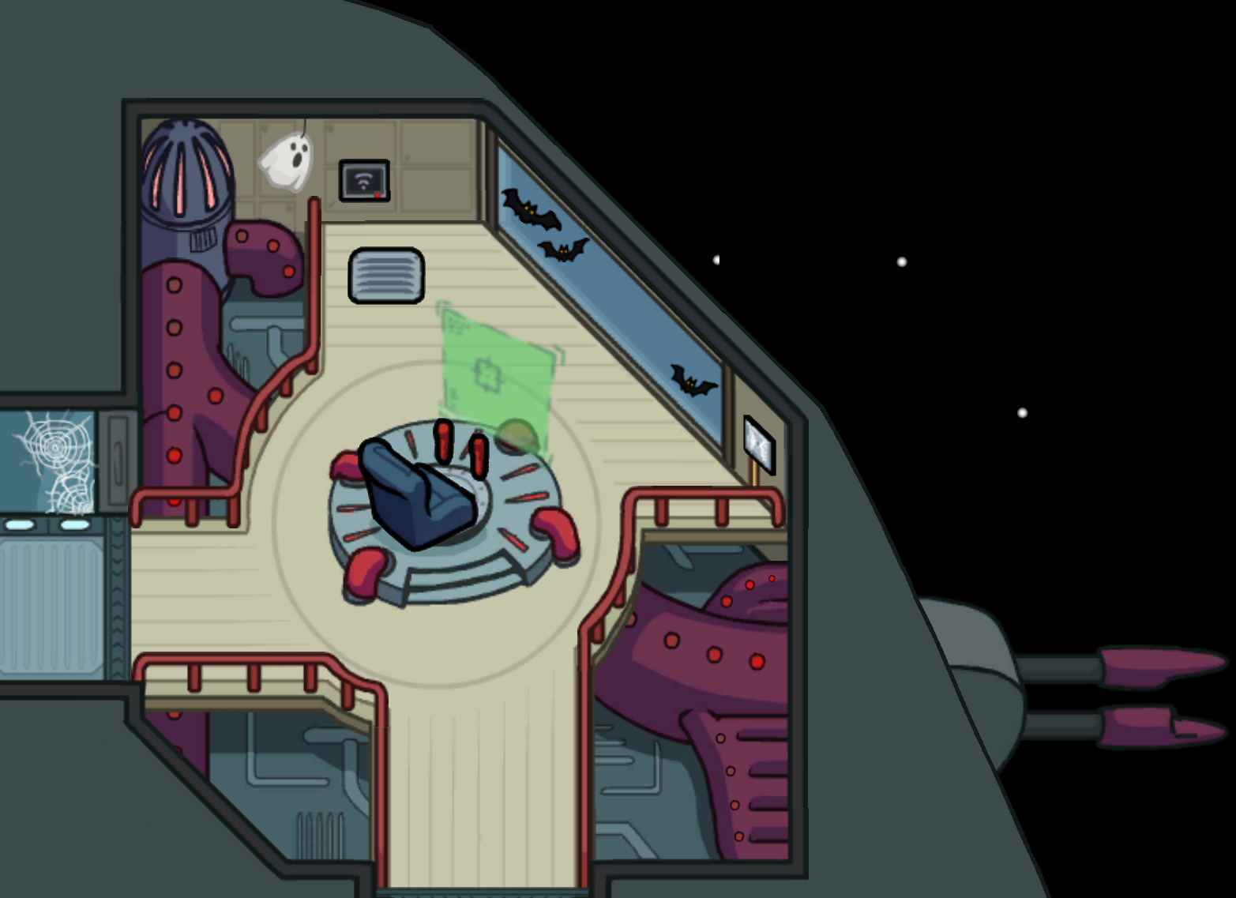
Weapons

Slide 20
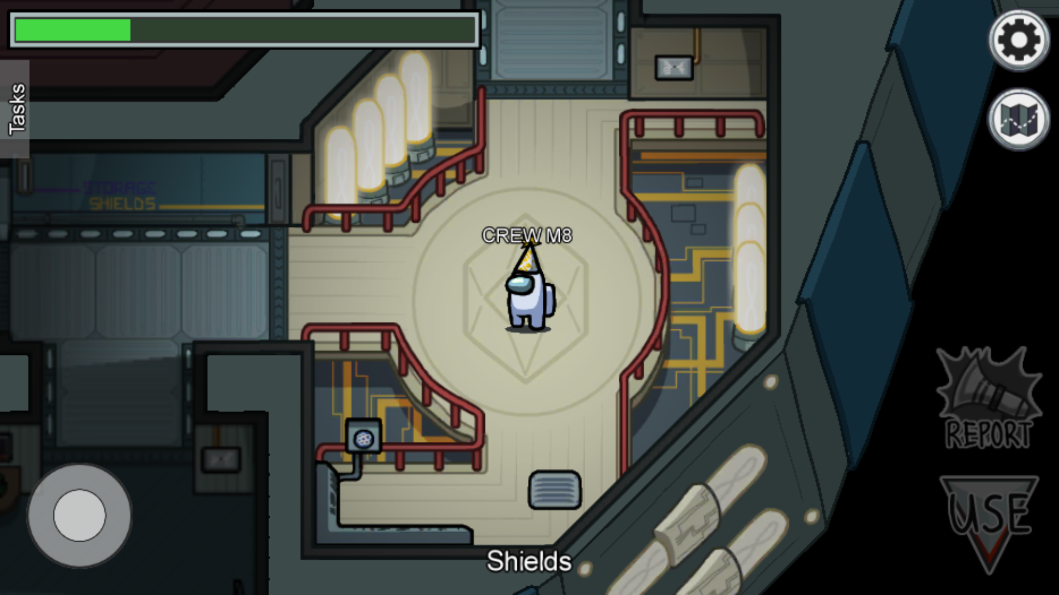
Shields

Slide 21
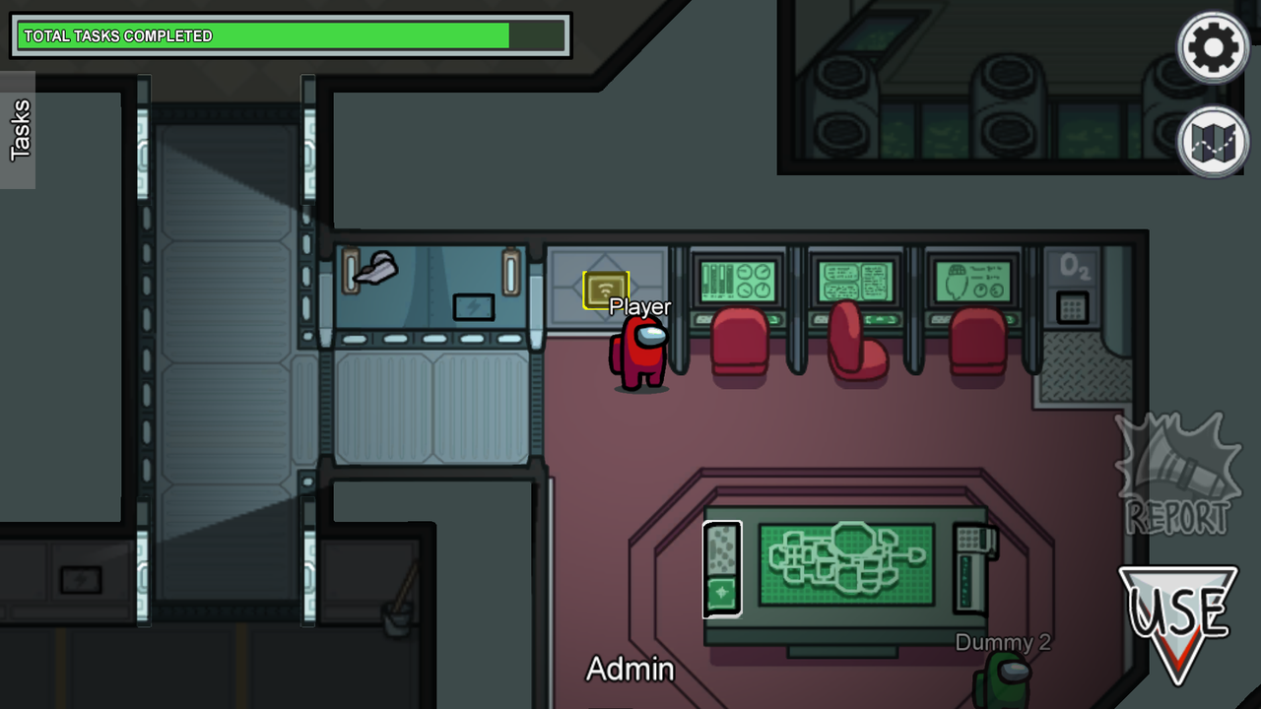
Admin

Slide 22
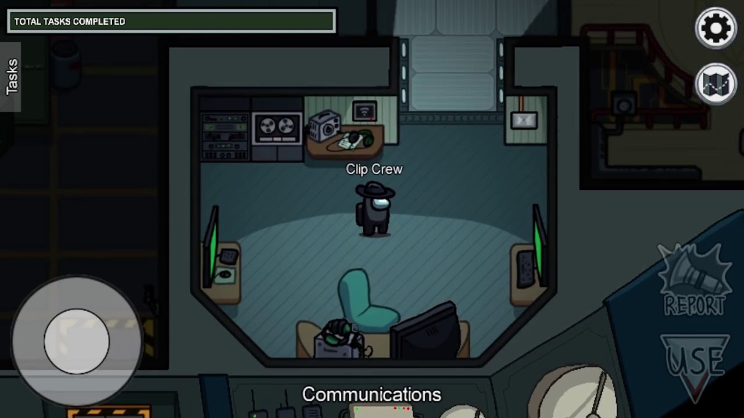
Communications

Slide 23
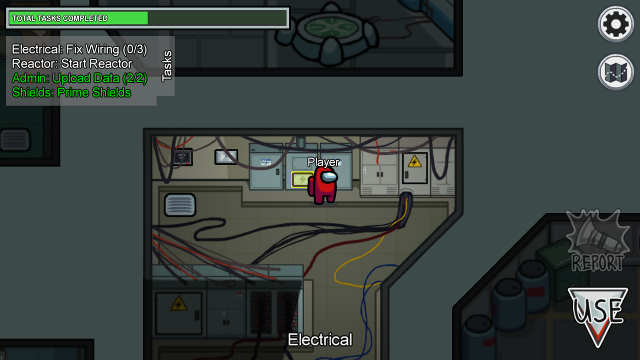
Electrical

Slide 24
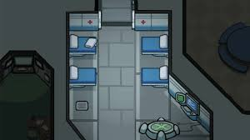
MedBay

Slide 25
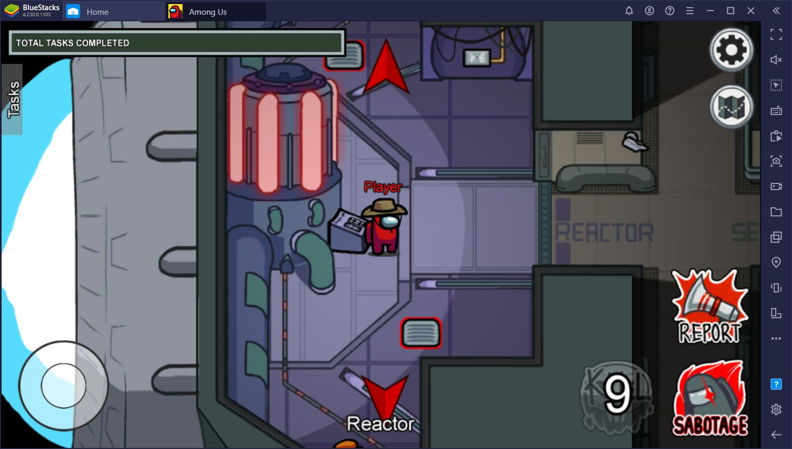
Reactor

Slide 26
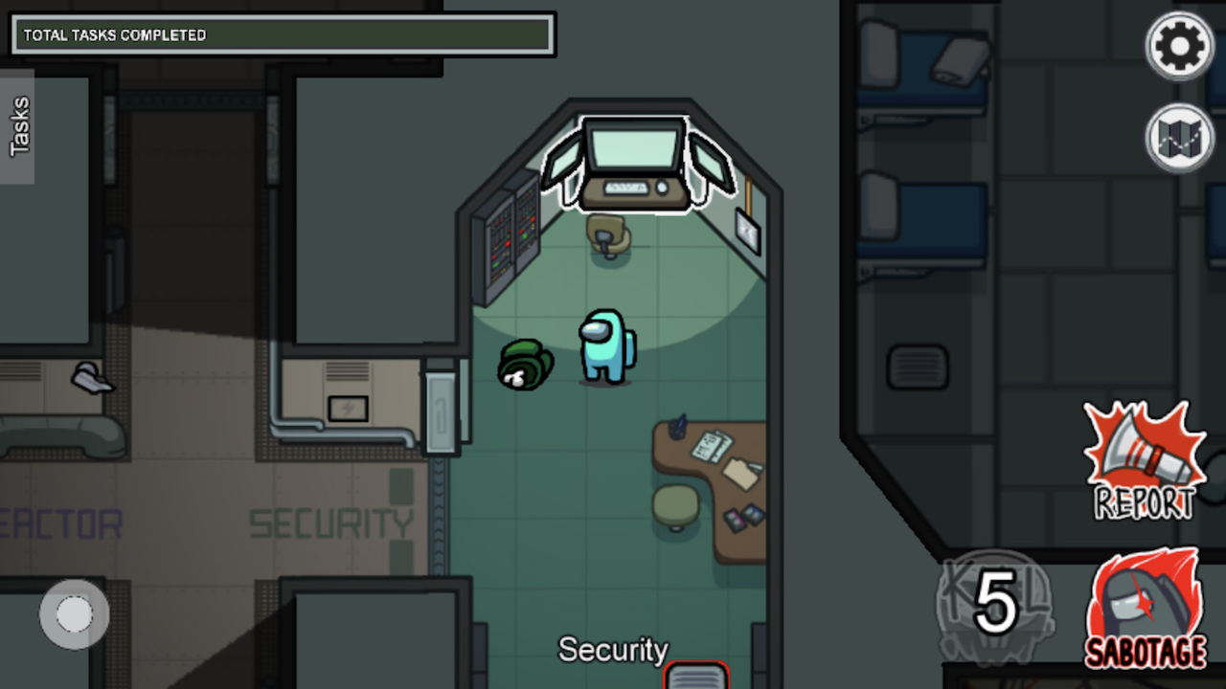
Security

Slide 27
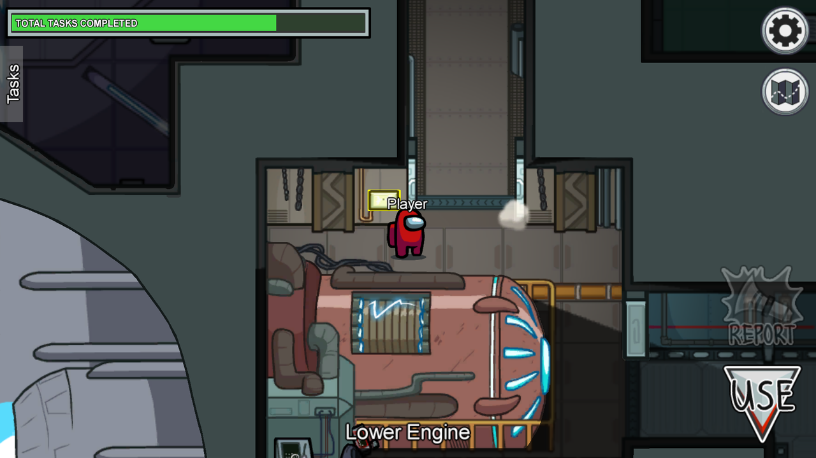
Lower Engine

Slide 28
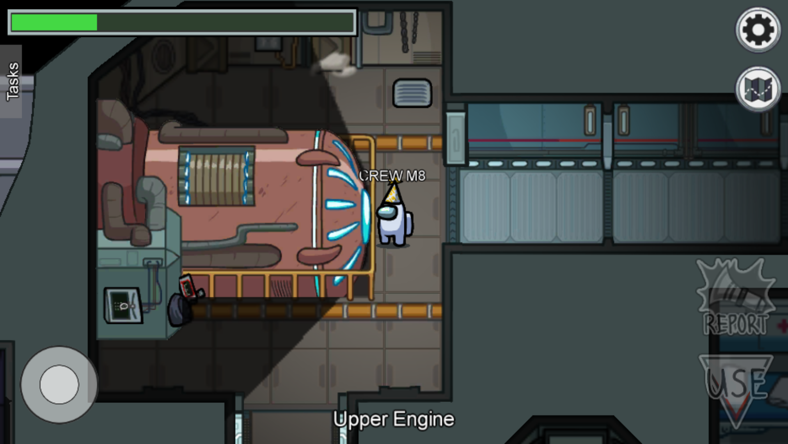
Upper Engine

Slide 29
vICTORY

